Slide 1
The Principles of Design

Slide 2
VARIETY

Slide 3
Variety is achieved when the art elements are combined in various ways to increase visual interest.
For instance, an assortment of shapes that are of a variety of sizes attracts more attention than an assortment of shapes all the same size.

Slide 4
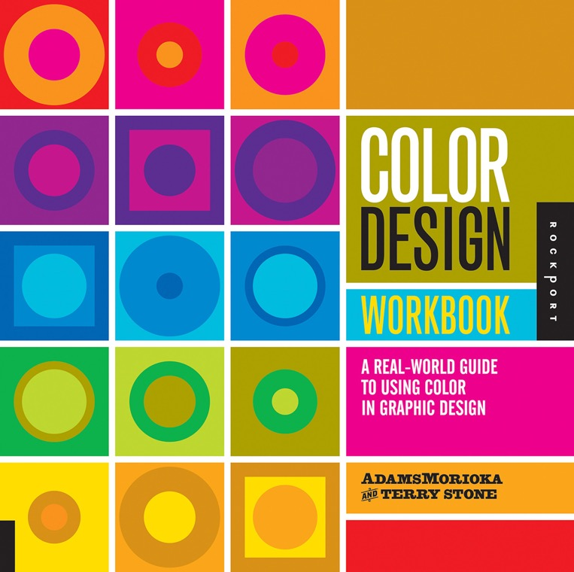
In this book cover design, variety is reached through the use of pattern, and asymmetrical balance.
Asymmetrical balance
Pattern

Slide 5
Here, the artist is using variety through the use of contrast between the colors and black, size-found in the different sizes of text, line-found in the curve of the 2 and the straight lines of the division.

Slide 6
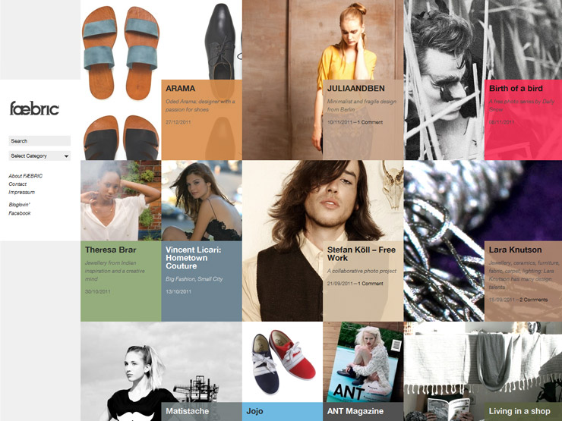
While the grid in this layout is a repetitive pattern of squares, The artist is using variety in that some squares are filled with pictures, some color boxes and other content.

Slide 7

Bad Design
This design is using a great deal of variety as well, but it is a bad design. Why? There is no Unity to the design, it is all random. There is no Focal-Point and everything is working on its own, not together.

Slide 8
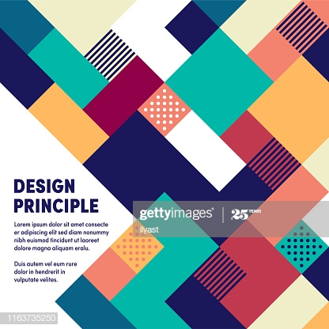
Good Design
This design is using a great deal of variety through the use of the different textures in the squares. It also is using asymmetrical balance along with positive and negative space.

Slide 9
THE PRINCIPLES OF DESIGN IN REVIEW
The Principles of Design are the ways that artists use the Elements of Art to create good Compositions (artwork)
Balance
Contrast
Emphasis/Focal Point
Variety
5. Unity/Harmony
6. Proportion
7. Rhythm/Movement
8. Pattern/Repetition

