Slide 1
The Principles of Design

Slide 2
UNITY / HARMONY

Slide 3
This principle refers to the visual quality of wholeness or oneness that is achieved through effective use of the elements of art and principles of design.
The Unity Principle of Design is commonly known as one of the more complex principles and incorporates other, more basic design principles such as repetition, proximity, and alignment.

Slide 4
Unity can be defined as the state of forming a complete and pleasing whole.
Unity is the feeling of harmony between all parts within the design, which creates a sense of completeness.
Some would say that a piece is not successful until it feels unified.

Slide 5
Most designs use a balance of unity and variety Unity is shown through repetition and order, and variety incorporates asymmetry and disorder.
Unity can be achieved in design a few different ways – placing objects in close proximity to each other, repeating elements, consistent alignment or use of grids, or continuation of lines (connecting elements together).

Slide 6
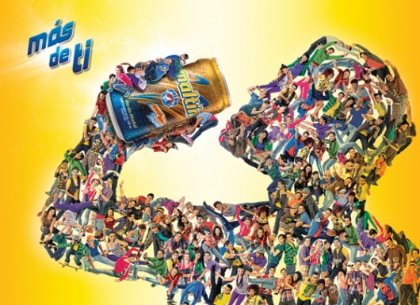
What do you think the artist used to keep this Ad unified or working together?

Slide 7
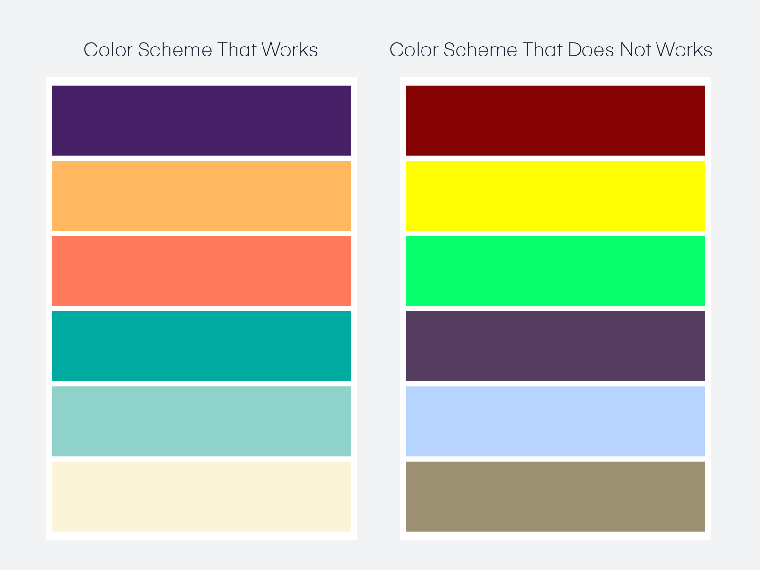
Visual unity is best described as harmony, which is a design principle in its own right. It can apply to colors, using styles that work well together, and in some cases, repeating styles to maintain visual consistency. For example, visual unity could be considered when choosing two different colors that need to complement each other well (harmony), or choosing the same color for two different buttons because they’re equally important (repetition).

Slide 8
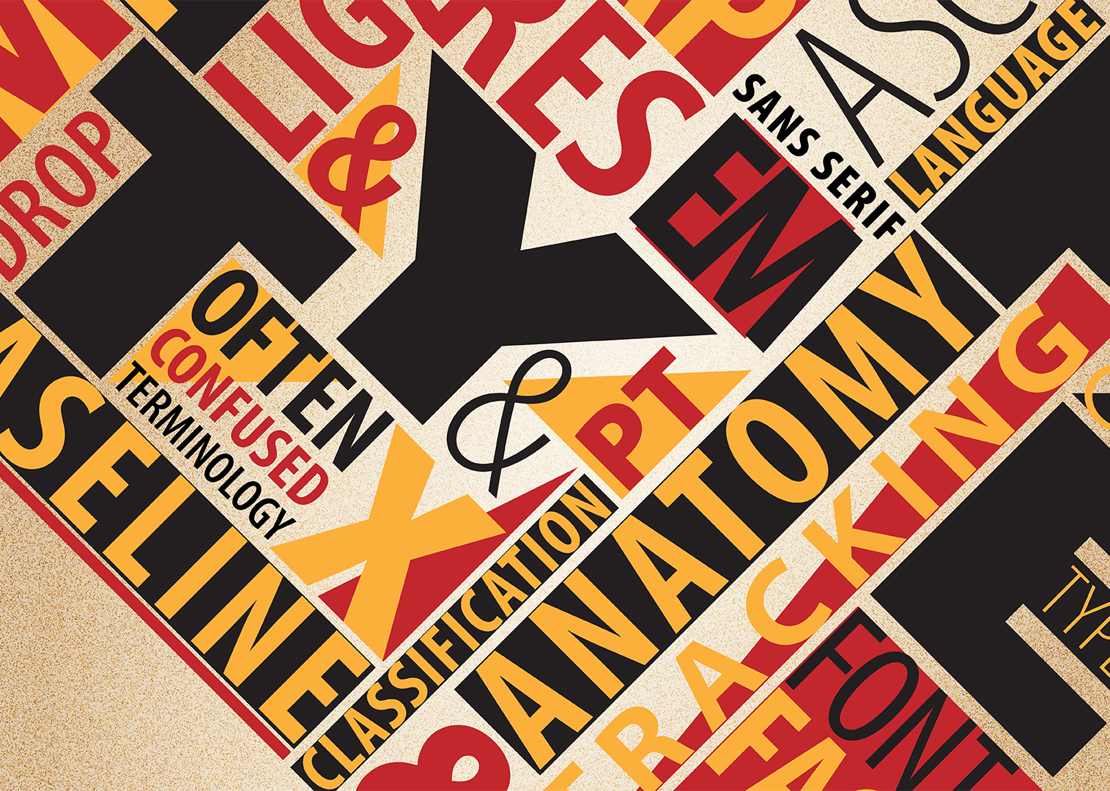
What do you think the artist used to keep this Ad unified or working together?
Here, Unity is achieved the arrangement of the text on perbindicular planes, along with the contrast of colors and size of line.

Slide 9
Here the artist used individual photograph prints and juxtaposed them together to create the number 20

Slide 10
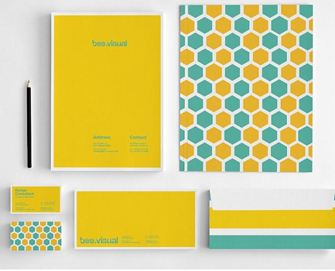
Unity / Harmony
in Graphic Design
This is a stationary package which is branding the company. The design across pieces is unified through color, pattern and use of line.

Slide 11
Color isn't always going to be the method that you use to establish unity.
You want to bring all the other principles of design together to create a design that makes sense to the viewer.
There's many ways this can be achieved. Similar shapes are a great way to establish unity in a design.

Slide 12
If you look at the image to the left, what shape do you see repeated throughout the layout?
The image is made up of individual squares and there are small square boxes on the right of the text. The repeated shape is what brings this layout together and makes it unified.

Slide 13
THE PRINCIPLES OF DESIGN IN REVIEW
The Principles of Design are the ways that artists use the Elements of Art to create good Compositions (artwork)
Balance
Contrast
Emphasis/Focal Point
Variety
5. Unity/Harmony
6. Proportion
7. Rhythm/Movement
8. Pattern/Repetition

