Slide 1
PATTERN / REPETITION

Slide 2
Repetition is simply repeating a single element many times in a design. For example, you could draw a line horizontally and then draw several others next to it.

Slide 3
We use repetition to create a sense of unity and consistency throughout a design. Repetition creates a particular style, creates cohesiveness, creates emphasis, hierarchy structure and strengthens a design.

Slide 4
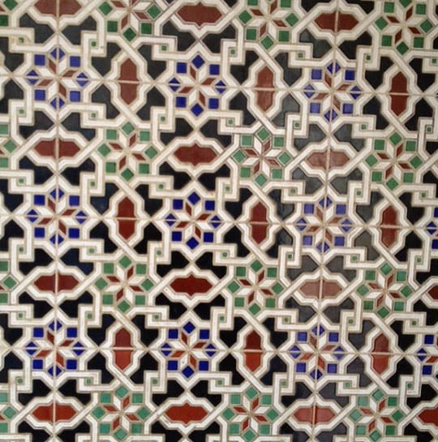
Using a pattern can be complex. As with this photograph, however, patterns can be used to put the user at ease and to allow them navigation tools throughout the design.
The use of patterns can enhance the user experience, as well as the design and look of the final product, but must be used wisely so as to avoid a complicated layout or unattractive design.

Slide 5
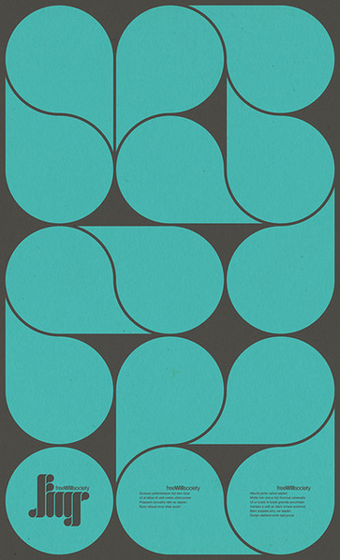
By repeating elements, we as designers not only deliver according to our users’ expectations in this way, but we also improve their experience. Our being consistent makes the users more comfortable.

Slide 6
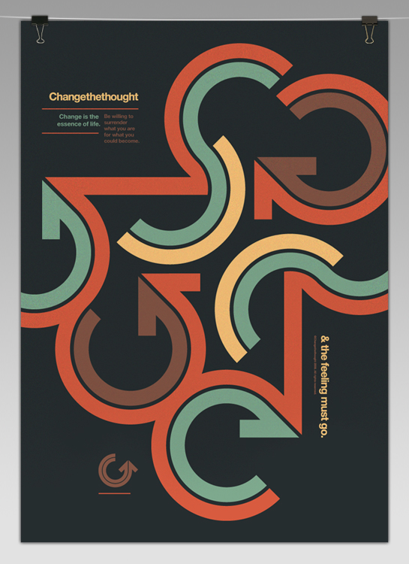
Using repetition to keep the eye familiar with our design’s elements means we’re taking advantage of this tendency. We can also use shapes, colors, textures, fonts, etc. to maintain this consistency via repetition.

Slide 7
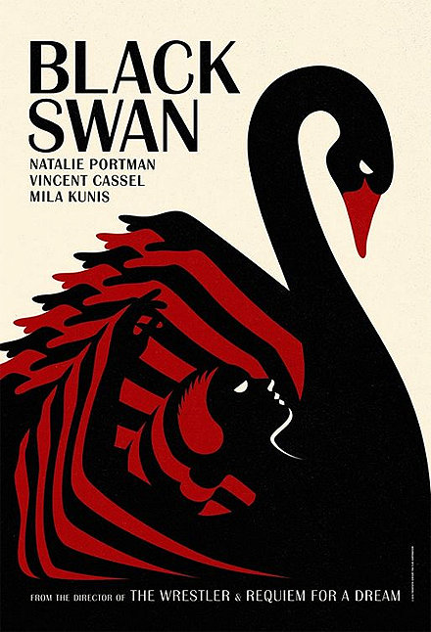
The ultimate goal of any piece of graphic design is to make an impression, hopefully a lasting impression.

Slide 8
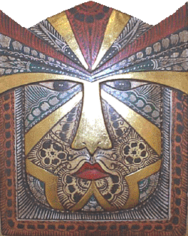
What elements has the artist used in this mask to create pattern?
Artist Unknown,Indonesian, Wall Plaque,

Slide 9
This decorative wall plaque is a great example of how an artist uses lines and shapes to create patterns.

Slide 10
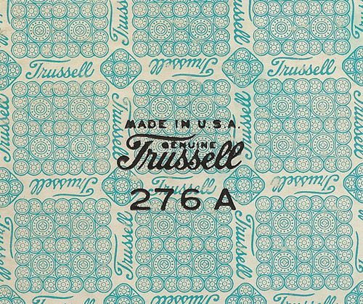
Would this piece be as interesting if the artist had used a solid background rather than this patterned one?

Slide 11
REPETITION: A way of combining art elements so that the same elements are used over and over to achieve balance and harmony.

Slide 12
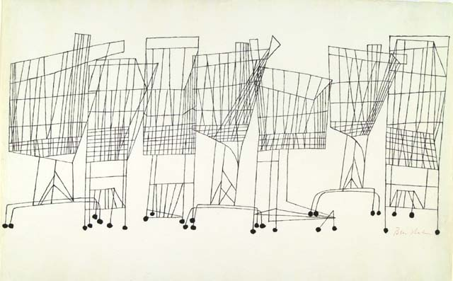
Ben Shahn has shown repetition in his work, Supermarket by repeating the same subject over and over to create an interesting composition. He used the same type and thickness of line and the same shapes

Slide 13
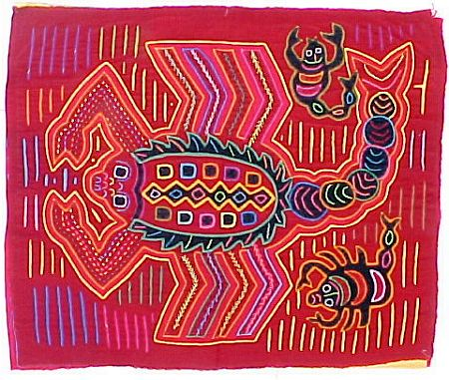
This beautiful Scorpion Mola, by an unknown artist , from the Panama Canal Kuna Indians, shows repetition of what elements of art?

Slide 14
Shapes, colors and lines are repeated.

Slide 15
Repetition in Graphic Design

