Slide 1
Digital Scavenger Hunt
By: Shyrbel Celira
Per. 5
Fall 2014

Slide 2
Button
A small disk or knob that is usually sown onto a piece of clothing to security or for decoration.
Can come in different sizes, colors, and shapes.
Something that you can press in order for an action to happen.

Slide 3
Red
A color that is at the end of the spectrum next to orange.
Often represented as the color of anger, fire or danger.

Slide 4
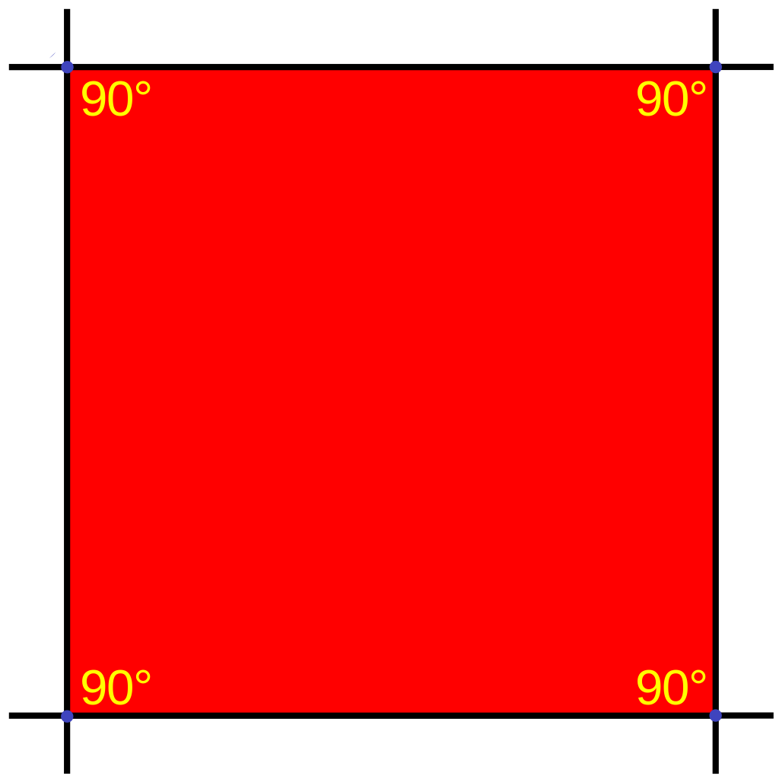
Square
A shape that has four equal sides and angles.

Slide 5
Clutter
Describes
mess
or
unorganized
space

Slide 6
Underneath
The opposite of above. Describes something that is below.

Slide 7
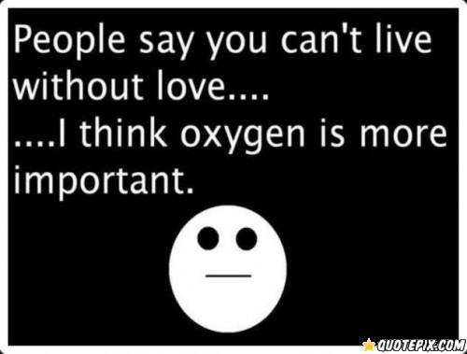
Can’t Live Without
A phrase that expresses feeling of love towards something.
Expresses that you adore something and it is necessary.

Slide 8
Stripes
Lines or bands that are evenly spaced.
Is usually colored and shows design.

Slide 9
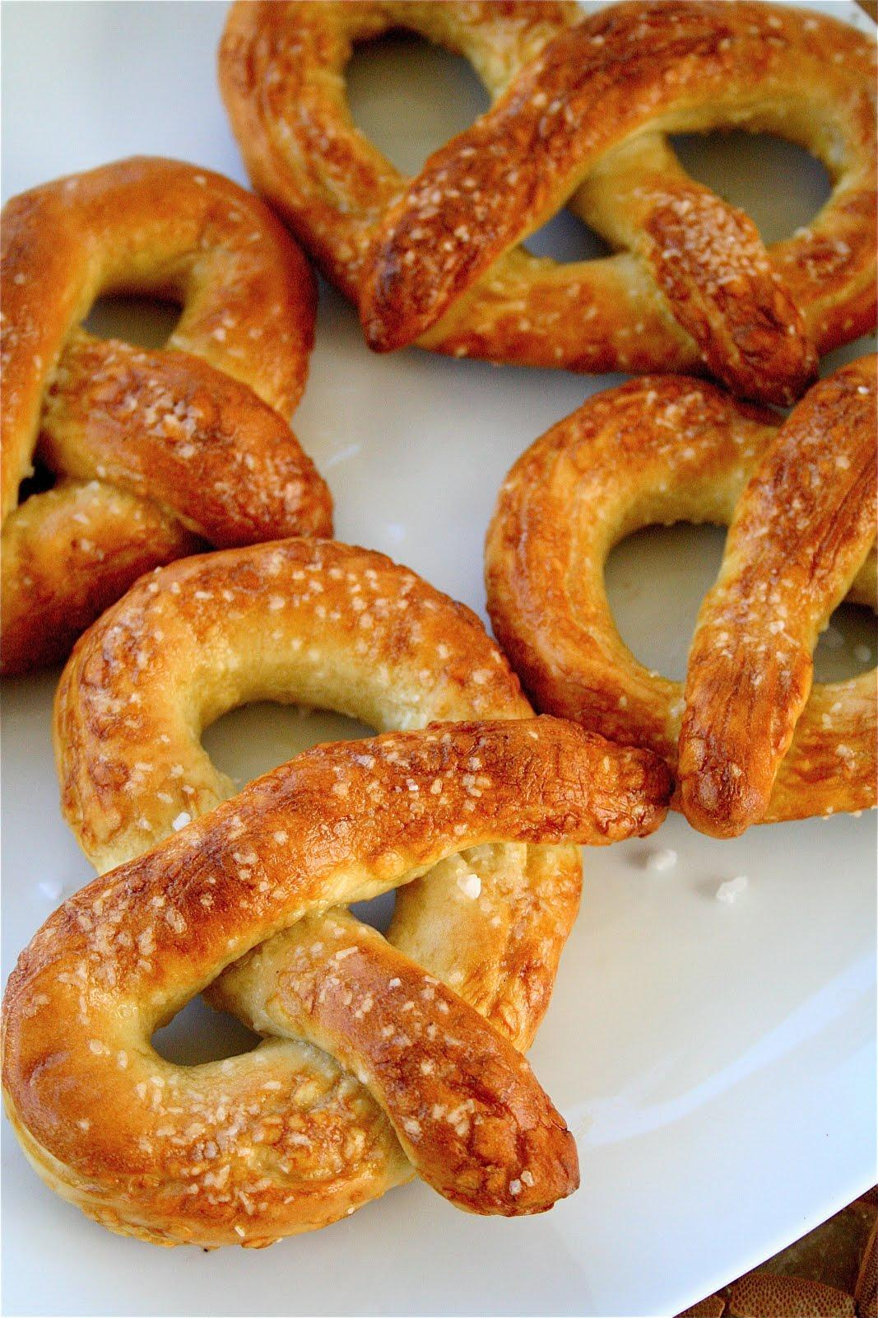
Curvy Lines
Lines that are not straight. Shows a bent in a straight line.

Slide 10
Sound
Something that we hear or is produced. Music produces sound that we can hear.

Slide 11
Empty
Something that is not filled. It contains nothing.

Slide 12
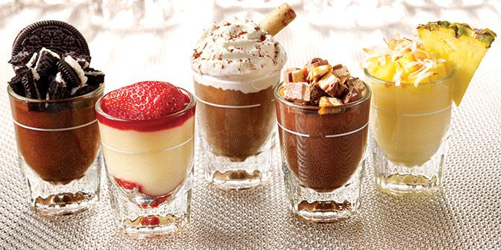
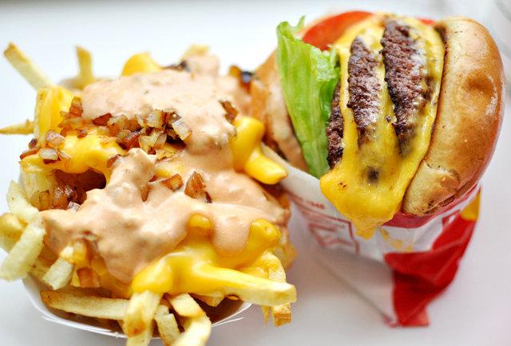
Delicious
Something, usually food, that taste extremely good. A pleasant taste.

Slide 13
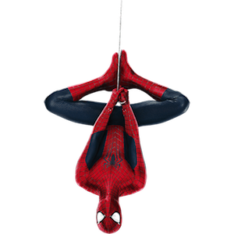
Upside Down
When something is in inverted order. When the top is place in the bottom.

Slide 14
Silence
When nothing can be heard. There are no sounds.

Slide 15
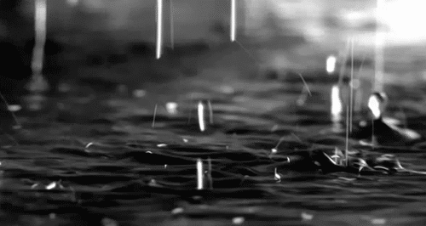
Water
An essential liquid that is used to hydrate living things. It is usually colorless, odorless, and tasteless. It mainly comes from lakes, rivers and oceans.

Slide 16
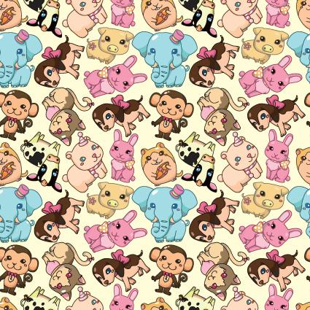
Pattern
It is a design that is chosen to decorate something.
An arrangement of objects in a specific order.

Slide 17
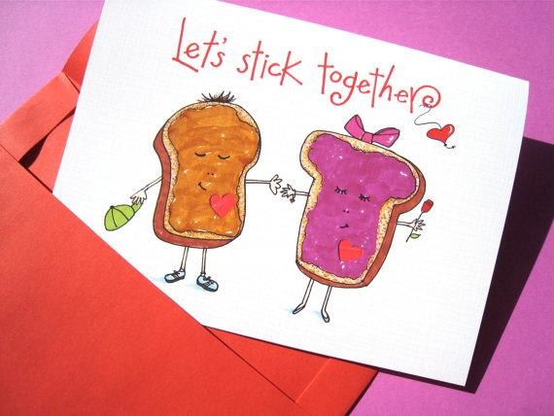
Together
To be with something or someone.

Slide 18
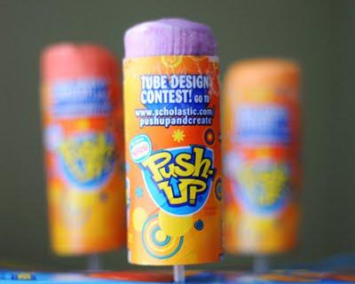
Push
A movement in which you exert force from your hand on something in order for a movement to happen.

Slide 19
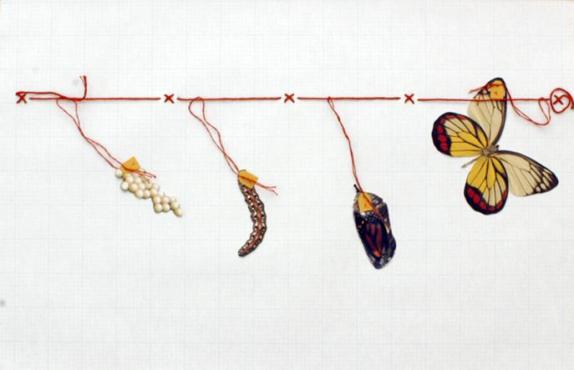
Develop
To grow or to create something.

Slide 20
Passion
A strong love. Shows strong emotion towards something.

Slide 21
Sources
Title Page - http://ninucella.blogspot.com/2013/01/summer-dreams.html
Button - http://mighelp.dataglobe.eu/
- http://www.thinkmaze.com/dont-press-button/
Red - http://stickywallpapers.com/2014/wallpapers/awsome-backgrounds-amp-wallpapers-red-background-hd-2014
- http://magicwithmedicine.wordpress.com/
- http://www.appgraffiti.com/layout/32085/Red-Fire
- http://www.sincemydivorce.com/why-we-ignore-red-flags-in-relationships/
Square - http://www.coolhdbackground.com/high-resolution/colorful-square-19-wallpaper-background-hd.html
- http://en.wikipedia.org/wiki/Square
- http://www.librarything.com/topic/161393
Clutter - http://clutterfairyhouston.com
Underneath - http://www.fanpop.com/clubs/the-little-mermaid/images/7593466/title/under-sea-fanart
- http://www.highaperture.com/u/n/under_the_bridge/under_the_bridge-26.html
- http://halocustoms.com/threads/unless-youve-been-living-under-a-rock.12966/
Can’t Live Without - http://quotepix.com/2567/order/recent
- http://www.goodtoknow.co.uk/recipes/pictures/34287/food-you-can-t-live-without
- http://www.masterdiz.com/indx/backgrounds/moves/cld07.htm
Stripes - http://s1176.photobucket.com/user/shellnestro/media/omgGIFS/spongebob-stripedsweater.gif.html
- http://hdwallsource.com/stripe-wallpapers-25490.html
Curvy Lines - http://www.landscapinggallery.info/horizontal-lined-paper/horizontal-lined-paper.htm
- http://www.thecurvycarrot.com/2010/11/03/hot-buttered-pretzelsl
- http://thinkprogress.org/politics/2011/04/26/161276/penn-parents-cookies-cuts/
Sound - http://theficklepen.com/?attachment_id=381
- http://www.iconarchive.com/show/ios7-style-metro-ui-icons-by-igh0zt/MetroUI-Other-Sound-icon.htm
- http://www.libertytyler.com/ComeSeeAShow/SoundofMusicsingalongversion.aspx l
Delicious - http://cutebackgroundwallpapers.blogspot.com/2011/08/set-of-food-wallpapers-set-2.html
- http://www.thrillist.com/eat/los-angeles/13-things-you-didn-t-know-about-in-n-out-burger-thrillist-los-angeles
- http://sugarandvanillawind.tumblr.com
- http://www.solutionstalk.com/home/2014/04/25/foodie-friday-save-room-3-delicious-dessert-trends-for-2014/
Upside Down - http://vintagechurchresources.com/upside-down-living/
- https://filmgamesetc.com/review/amazing-spider-man-2-2014-game-review/
Silence - http://www.reddit.com/r/LifeProTips/comments/20zmls/lpt_request_where_can_i_go_to_meet_new_people/
- http://www.layoutsparks.com/pictures/quiet-0
- http://www.disneyclips.com/imagesnewb4/snowwhite_dopey.html
- http://www.pinterest.com/missdeby/aladdin-lamps-carpets/
Water - http://simplyorthodox.tumblr.com/post/30805069991
- http://www.fimfiction.net/story/133948/it-all-started-with-a-glass-of-water
- http://davidkanigan.com/tag/quotations/page/2/
Pattern - http://megahdwall.com/high-resolution-wallpaper/leopard-print-colorful-pattern-twitter-607484.html
- http://www.polyvore.com/funny_girly_colourful_patterns_moustaches/thing?id=71109181
- http://freedesignfile.com/35187-cute-seamless-pattern-design-vector-01/
- http://naldzgraphics.net/freebies/seamless-animal-patern/

Slide 22
Sources
Together - http://thompsonblogs.org/altepeter/2011/09/
- https://www.etsy.com/listing/120998455/funny-i-love-you-card-anniversary-peanut
- http://www.couplescostumes.com/theme/food-costumes.html
- http://www.wearapear.com/famous-pairs/
Push - http://www.freestockphotos.biz/stockphoto/9287
- http://www.clker.com/clipart-man-push.html
- http://taraburner.com/health-wellness/howmanypushups.php
Develop - http://www.superghostblogger.com/6-great-ways-to-develop-your-website/
- http://www.bizengine.com/small-business-ideas/
-http://www.shutterstock.com/video/clip-5940980-stock-footage-grass-growing-background-fps-artificial-and-stylized-blades-of-grass-growing-upwards-in-frame.html
Passion - http://mahyanp.deviantart.com/art/Patterned-Backgrounds-284882929
- https://plus.google.com/105197885980906115076/posts
-http://www.movedbypurpose.net/5-steps-find-passion/
Sources - http://favim.com/image/271486/
- http://background-pictures.picphotos.net/vintage-floral-print-tumblr-background-vintage-backgrounds/data1.whicdn.com*images*35294210*large.jpg/
- http://imgkid.com/blue-floral-background-tumblr.shtml
The End - http://takeinsocialmedia.com/background/the-end-background-images-photos-16191

