Slide 1
Digital Scavenger Hunt
Sarah Quijencio, Period 4, Fall 2014

Slide 2
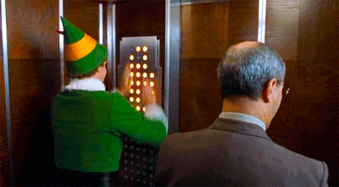
Buttons - [buht-nz] noun.
1. A small knob pressed to activate an electrical circuit or operate a machine, etc;
Draco pressed the button and the hidden door opened wide.

Slide 3
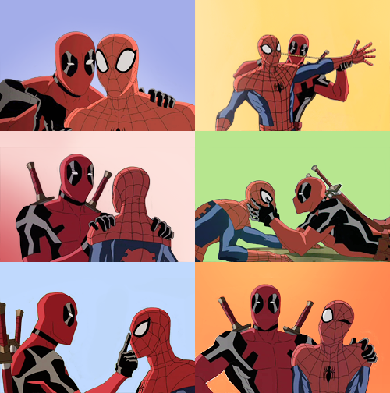
Red - [red] adjective.
1. Of the color red;
The colors of both Deadpool and Spiderman’s costume consist of the color red.

Slide 4
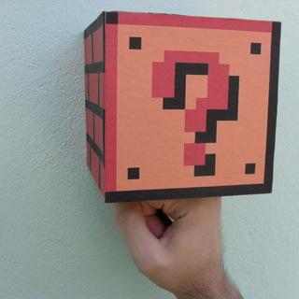
Square - [skwair] noun.
1. A rectangle with four sides that are equal lengths;
If you punch the square box in Mario, you have a chance of getting a 1-Up.

Slide 5
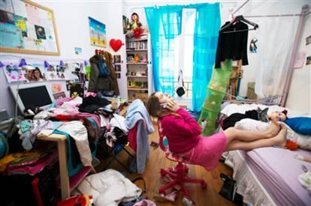
Clutter - [kluht-er] noun.
1. Litter or a giant disorderly heap;
The girl paid no attention toward the clutter in her room.

Slide 6
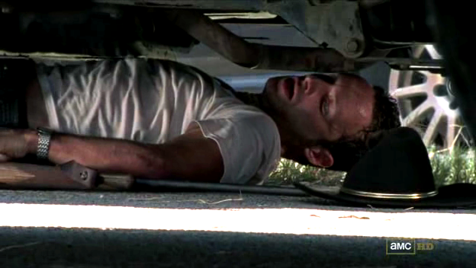
Underneath - [uhn-der-neeth] adverb.
1. On a lower position, or bottom;
Rick hid underneath the car in order to hide from the walkers.

Slide 7
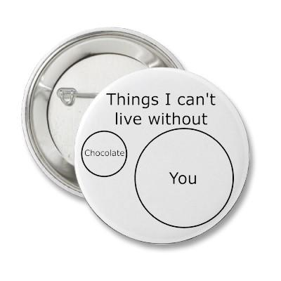
Can’t Live Without - phrase
1. The saying of not being able to go on without a certain something or someone;
Some things I can’t live without is chocolate and you but mostly chocolate.

Slide 8
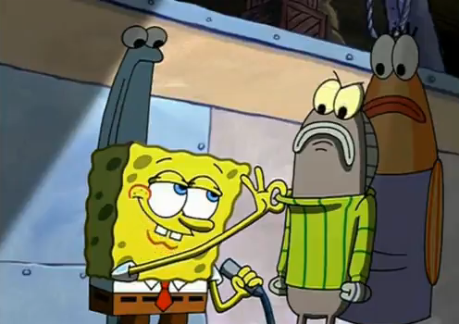
Stripes - [strahyp] noun.
1. A long line/band that is of different color, appearance, etc;
Spongebob once sang a song about wearing sweaters with stripes all the time.

Slide 9
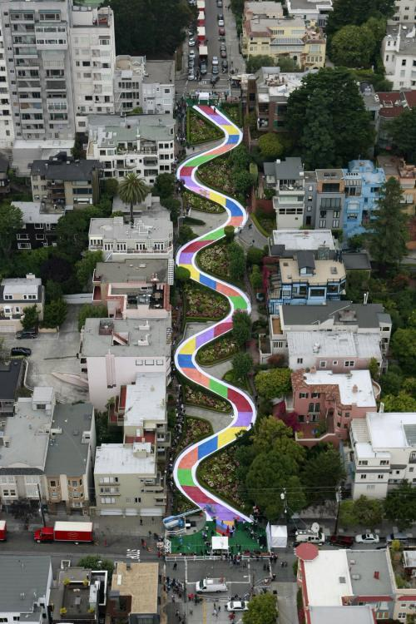
Curvy Lines - noun.
1. A line that bends smoothly with no sharp angles;
Lombard Street is a curvy line or street that people can drive on for fun.

Slide 10
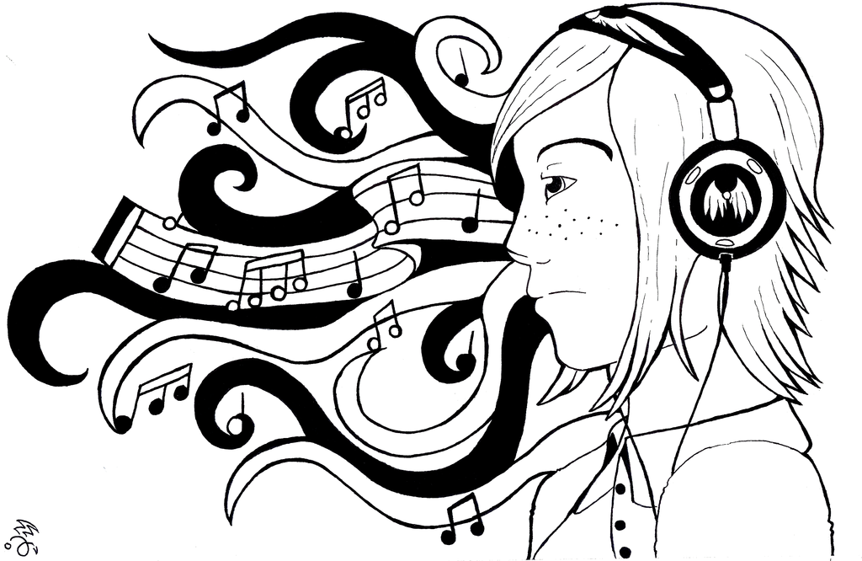
Sound - [sound] noun.
1. An auditory effect produced by a given cause;
The sound of music was heard from the headphones.

Slide 11
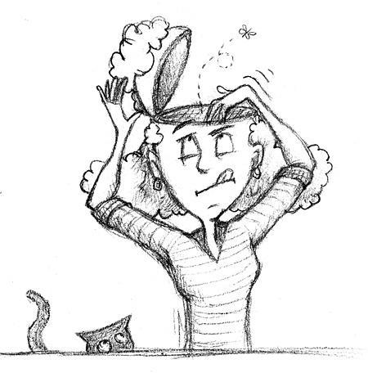
Empty - [emp-tee] adjective.
1. Vacant, containing nothing;
The girl’s head sounded empty like there was nothing in there.

Slide 12
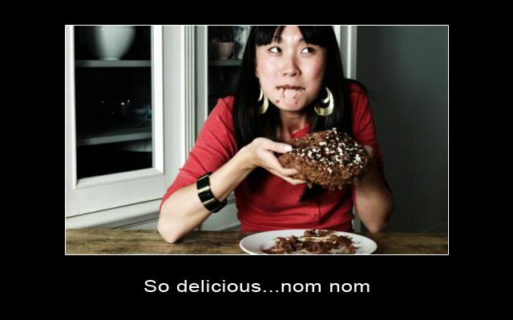
Delicious - [dih-lish-uh s] adjective.
1. Very pleasing, especially to smell and taste;
The chocolate cake that Emily baked tasted delicious as she took a giant bite of it.

Slide 13
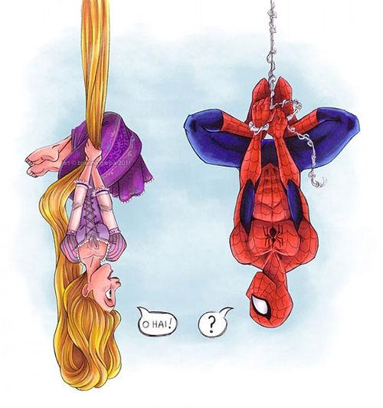
Upside Down - noun.
1. With the top part, undermost;
Spiderman hung upside down alongside Rapunzel who hung by her long hair.

Slide 14
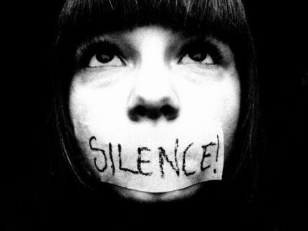
Silence - [sayh-luh ns] noun.
1. Absence of any sound;
When watching a movie there needs to be silence but if you’re not quiet, there’s always duct tape.

Slide 15
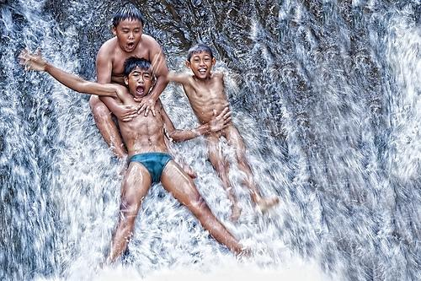
Water - [waw-ter] noun.
1. A variety form or a liquid;
The water was clear as day as the three kids went down the waterfall.

Slide 16
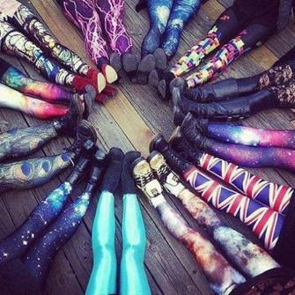
Pattern - [pat-ern] noun.
1. A decorative design such as tile, texture, etc;
All the girls included in the circle all have crazy patterns on their leggings.

Slide 17
Together - [tuh-geth-er] adverb.
1. Into or in unity, contact, proximity, and such;
The team members came together to discuss their game plan.

Slide 18
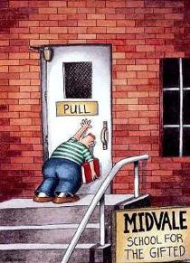
Push - [poo sh] verb.
1. To push upon or press against with force to move away;
The guy tried to push open the pull door but failed miserably.

Slide 19
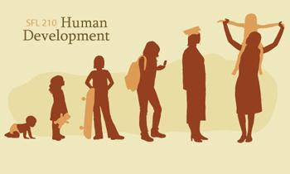
Develop - [dih-vel-uh p] verb.
1. To grow or develop into a more advanced stage;
Everyone eventually develops into a grown and matured adult.

Slide 20
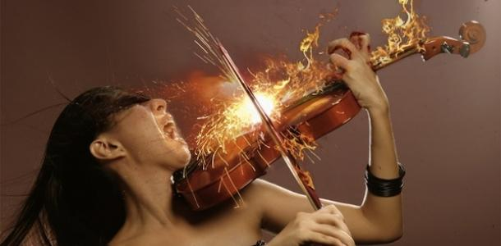
Passion - [pash-uh n] noun.
1. A powerful or compelling emotion such as love or hate;
The girl played the violin with such passion symbolized by the fire.

