Slide 1
The
Space Project

Slide 2


Positive Space
Negative Space

Slide 3

  Negative Space
  Positive Space

Slide 4

  Which Do You See?

Slide 5
  Lets see some examples in use

Slide 6


Slide 7


Slide 8


Slide 9
Positive/Negative used in Logos

Slide 10


Slide 11


Slide 12
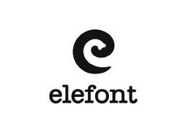

Slide 13


Slide 14
Positive/ Negative Type Solutions

Slide 15


Slide 16


Slide 17


Slide 18


Slide 19


Slide 20


Slide 21
The Project

Slide 22


