Slide 1
The Elements Of Art
SPACE

Slide 2
The Elements Of Art
SPACE refers to distances or areas around, between or within components of a piece.
Space can be positive (white or light) or negative (black or dark), open or closed, shallow or deep and two-dimensional or three-dimensional.
4. SPACE

Slide 3
The Elements Of Art
Without space there is no music. Try to imagine every note playing at the same time or being played so quickly that there’s no distinction between one note and the next. You wouldn’t have music.
4. SPACE

Slide 4
The Elements Of Art
You’d have a solid wall of noise.
You have to leave room for the sounds to be distinguished from each other, to be heard for what they are.
4. SPACE

Slide 5
The Elements Of Art
The same is true visually. There’s gotta be enough space.
Without whitespace none of your elements gets seen. They become noise.
4. SPACE

Slide 6
SPACE
These tubes represent the 3Dimensional version of a circle. This difference is the depth. A circle has no depth, a cylender has a depth. What makes this picture interesting is its use of color, perspective and focal point

Slide 7
The Elements Of Art
Space can be used to both separate and connect elements in a design. Wider spaces separate elements from each other and narrower spaces connect elements to reveal relationships between them. Overlapping elements maximizes their relationship.
4. SPACE

Slide 9
The Elements Of Art
By controlling and shaping space in our designs, we create rhythm, direction, and motion. We create design flow through our use of space.
4. SPACE

Slide 11
The Elements Of Art
Whitespace does three things in a design.
1. Creates groupings of elements 2. Creates emphasis and hierarchy 3. Improves legibility
4. SPACE

Slide 13
The Elements Of Art
Whitespace gives a place for the eye to rest, which it needs in order to absorb the message you’re trying to communicate. It’s a visual cue that there’s a break in the content or that the content is finished. Whitespace makes your page easier to navigate.
4. SPACE

Slide 14
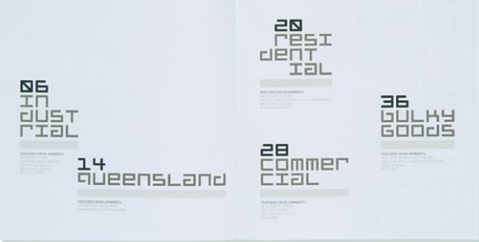

Slide 16
The Elements Of Art
Consistent use of negative space is a hallmark of professional design. Look at any design that strikes you as amateur. I can almost guarantee little thought will have been given to the space within the design.
4. SPACE

