Slide 1
Shepard Fairey
A Study of the Practices of the Artist

Slide 2
M
ost well known for his "Obey Giant" street posters, Shepard Fairey has carefully nurtured a reputation as a heroic guerilla street artist waging a one man campaign against the corporate powers-that-be. Fairey’s art is problematic for another, more troubling reason - that of plagiarism.

Slide 3
F
airey has developed a successful career through recontextualizing the artworks of others.
Pop artist Roy Lichtenstein based his paintings on the world of American comic strips and advertising imagery, but we as the audience were always aware that Lichtenstein was taking his images from a known source; that was after all his point, to examine the blasé and the artificial in modern American commercial culture.

Slide 4
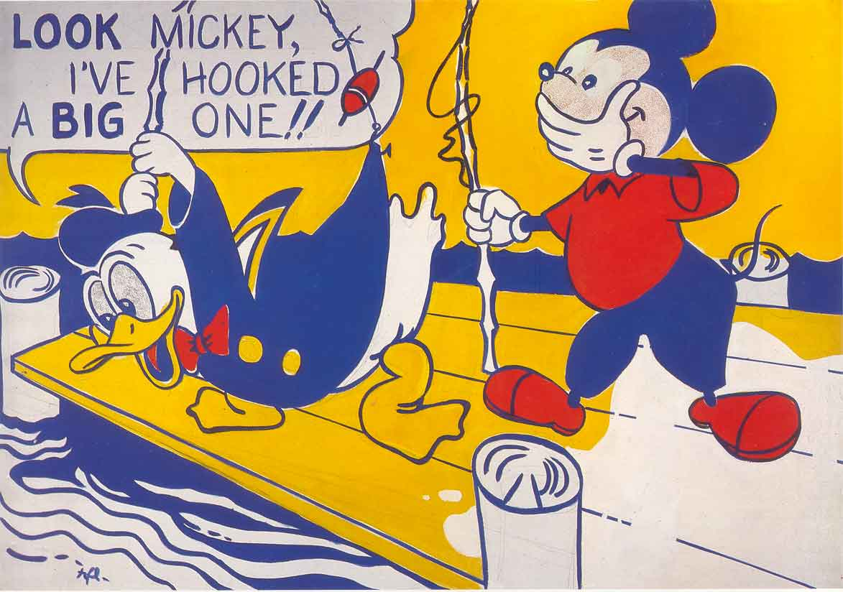
When Lichtenstein painted Look Mickey, a 1961 oil on canvas portrait of Mickey Mouse and Donald Duck, everyone was cognizant of the artist’s source material - they were in on the joke.
By contrast, Fairey simply takes artworks and hopes that no one notices - the joke is on you.

Slide 5
P
lagiarism is the deliberate passing off of someone else’s work as your own, and Shepard Fairey may be unfamiliar with the term - but not the act.
It is not about the innocent absorption of visual ideas that later materialize in an artist’s work.
Nor is it an artist’s direct influences - what artist can claim not to have been inspired by techniques or styles employed by others?

Slide 6
W
hat we should be concerned with is the brazen, intentional copying of already existing artworks created by others - sometimes duplicating the originals without alteration - and then deceiving people by pawning off the counterfeit works as original creations.

Slide 7
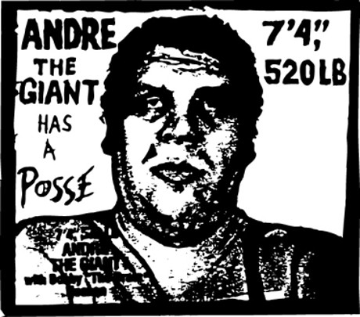
F
Fairey launched his career with a series of obscure street posters, stickers and stencils that combined the words "Andre the Giant Has a Posse" with the image of deceased wrestling superstar, Andre the Giant.

Slide 8
B
y the early 1990’s the images had become mainstay in major urban centers around the world.
Then, in 1993 Titan Sports, Inc. (now World Wrestling Entertainment, Inc.) threatened to sue Fairey for violating their trademarked name, Andre the Giant.

Slide 9
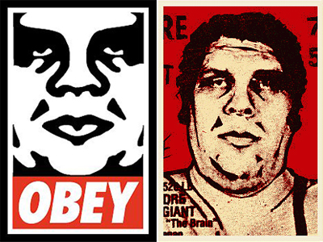
Fairey responded to the threatened lawsuit by altering his portrait of the famous wrestler, combining the new image with the word, "Obey".
Fairey’s self-titled "absurdist propaganda" campaign was born.

Slide 10
T
he supposed intent of the project, according to the artist, was to: "stimulate curiosity and bring people to question both the campaign and their relationship with their surroundings - because people are not used to seeing advertisements or propaganda for which the motive is not obvious."

Slide 11
T
he question is not what Fairey’s political allegiances may or may not be, but rather, how his work sets a standard that is ultimately damaging to art and leads to its further dissolution. When a will to plagiarize and a love for self-promotion are the only requirements necessary for becoming an artist, then clearly the arts are in deep trouble.

Slide 12
A
ctivity:
Break into groups of Four
Analyze the images to follow and discuss them in your group
Rate them on a scale of 1 for not the same 5 for kinda the same, and 10 for the same.

Slide 13
Still from director Michael Anderson’s 1956 film adaptation of George Orwell’s cautionary story of a dystopic future, 1984.

Slide 14
Fairey used this image for his own poster

Slide 16
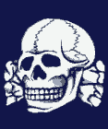
In 2006 Fairey printed an already existing skull and crossbones artwork he found, altering the original design only by adding the words "OBEY: Defiant Since '89" along with a small star bearing the face of Andre the Giant.
The image was reproduced as a T-shirt and added to Fairey’s OBEY fashion line.

Slide 17
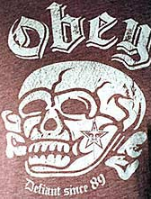
As luck would have it, Wal-Mart plagiarized the master plagiarist, copying and printing Fairey’s rip-off and adding it to the superstore’s own fashion line.
A shopper at Wal-Mart recognized the skull motif’s origin and angrily protested
- AS IT WAS AN EXACT DUPLICATION OF THE INFAMOUS LOGO BELONGING TO THE GESTAPO, THE NAZI "SECRET STATE POLICE"
that served as personal bodyguards to Adolf Hitler and administered the concentration camps where the genocide of the Jewish people was put into practice.

Slide 19
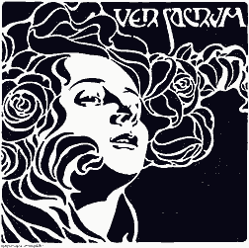
[Ver Sacrum - Koloman Moser 1901.
Front cover illustration for the Vienna Secession magazine, Ver Sacrum.]

Slide 20
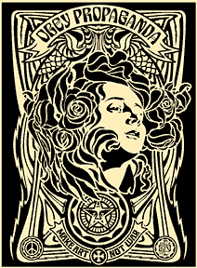
Fairey’s own self promotion poster

Slide 22
Fairey no doubt saw the cover art for Ver Sacrum and created an exact tracing of it, a tracing so precise that when the two versions are put together and held up to the light - all lines match perfectly.
Fairey merely altered Moser’s original work with some clumsy border enhancements, a small portrait of Andre the Giant, and the words, "OBEY Propaganda".

Slide 23
During the opening days of the Soviet occupation, Czech patriots glued anti-invasion posters all over the walls of Prague, the nation’s capital.
One daring but unidentified Czech artist created a street poster that portrayed the Red Army as liberators in 1945 - but oppressors in 1968.

Slide 24
Fairey’s own poster

Slide 26
Black Panther - Pirkle Jones. Photograph. 1968. Portrait of an anonymous Panther at a political rally in Oakland, California. The Panther photos of Ruth-Marion Baruch and Pirkle Jones are internationally famous and have long been available in book form.

Slide 27
Fairey’s street poster, which neither credits Pirkle Jones nor makes any mention of the Black Panther Party.]

Slide 29
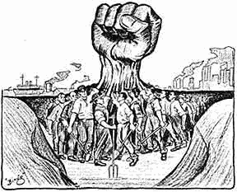
One Big Union - Ralph "Bingo" Chaplin. 1917. Artwork created for the Industrial Workers of the World.

Slide 32
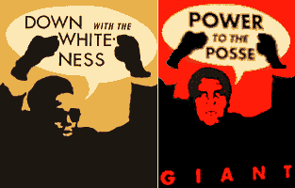
Down with the Whiteness – Rupert Garcia. Silkscreen print. 1969.
In the permanent collection of the Fine Arts Museum of San Francisco.

Slide 33
Shepard Fairey’s version of Garcia’s silkscreen.
Fairey published his version in his book, Supply and Demand. No credit was given to Rupert Garcia.]

Slide 35
T
he expropriation and reuse of images in art has today reached soaring heights, but that relentless mining and distortion of history will turn out to be detrimental for art, leaving it hollowed-out and meaningless in the process.
Fairey is guilty of utilizing historic images simply because he "likes" them, and not because he has any grasp of their significance as objects of art or history.

