Slide 1
The Elements Of Art
the building blocks of art and design.

Slide 2
The Elements Of Art
VALUE refers to the lightness or darkness of a color.
Value becomes critical in a work which has no colors other than black, white, and a gray scale.
6. VALUE

Slide 3
The Elements Of Art
For a great example of value in action, think of a black and white photograph. You can easily visualize how the infinite variations of gray suggest planes and textures.
6. VALUE

Slide 4
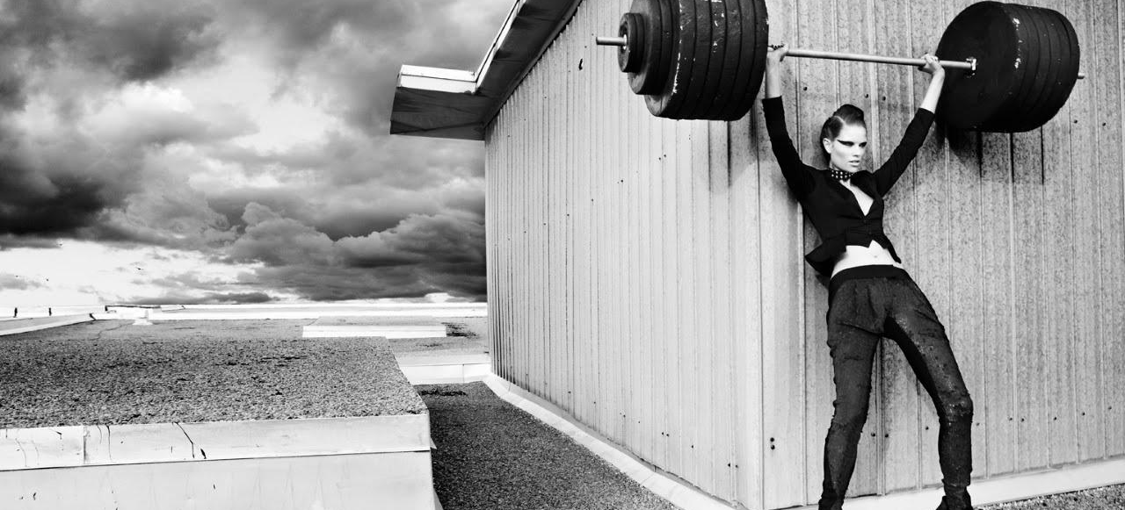
VALUE – Grayscale

Slide 5
The Elements Of Art
Categories of
Value
Tint is adding white to a color to create lighter values such as sky blue or pink.

Slide 6
The Elements Of Art
Categories of
Value
Shade is adding black to a color to create darker values such as indigo or maroon.

Slide 7
The Elements Of Art
Categories of
Value
High-Key is where the picture is all light values.

Slide 8
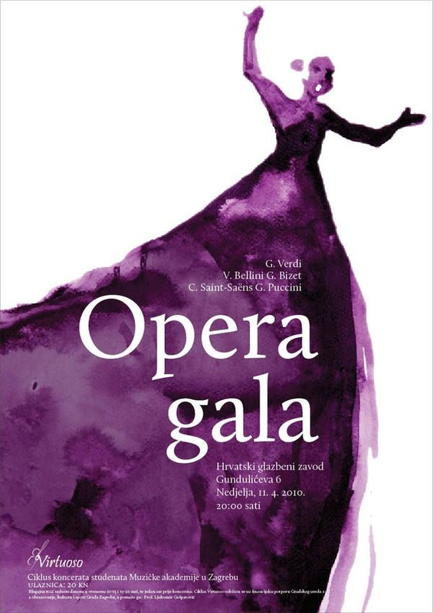
HIGH-KEY in Graphic Design

Slide 9
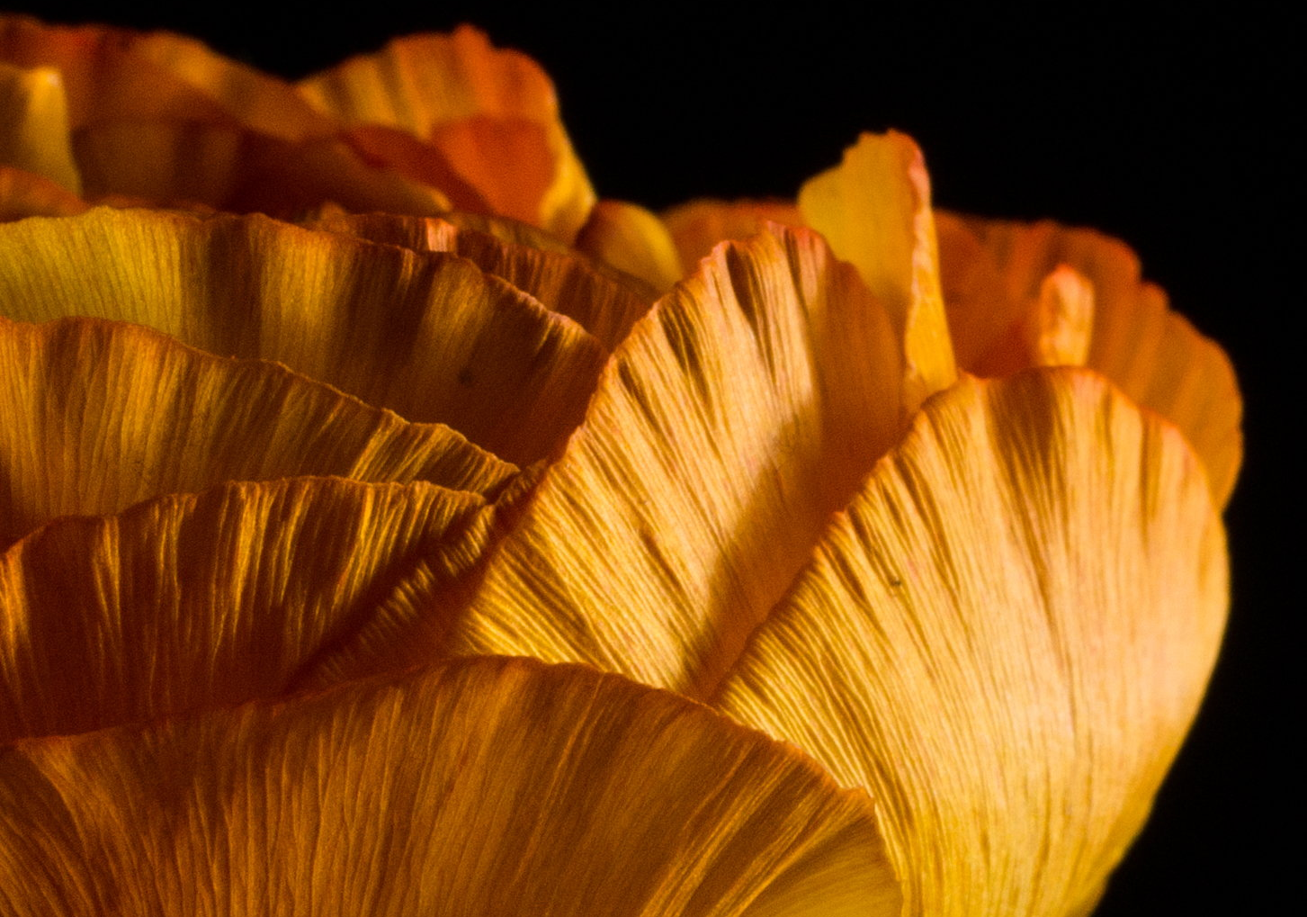
The Elements Of Art
Categories of
Value
Low-Key is where the picture is all dark values.

Slide 10
LOW-KEY in Graphic Design

Slide 11
The Elements Of Art
Categories of
Value
Value Contrast is where light values are placed next to dark values to create contrast or strong differences.

Slide 12
The Elements Of Art
Categories of
Value
Value Scale is a scale that shows the gradual change in value from its lightest value, white to its darkest value black.

