Slide 1
The Elements Of Art
the building blocks of art and design.

Slide 2
The Elements Of Art
TEXTURE is used to describe either the way a three-dimensional work actually feels when touched, or the visual "feel" of a two-dimensional work.
5. TEXTURE

Slide 3
The Elements Of Art
REAL TEXTURE is the actual texture of an object. Artist may create real texture in art to give it visual interest or evoke a feeling.
Categories of
Texture

Slide 4
The Elements Of Art
IMPLIED TEXTURE is where a piece of art is made to look like a certain texture. Like a drawing of a tree trunk may look rough but in fact it is just a smooth piece of paper
Categories of
Texture

Slide 5
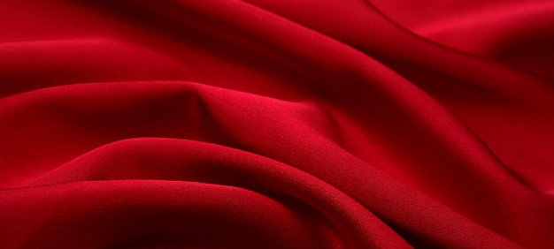
REAL TEXTURE – Smooth

Slide 6
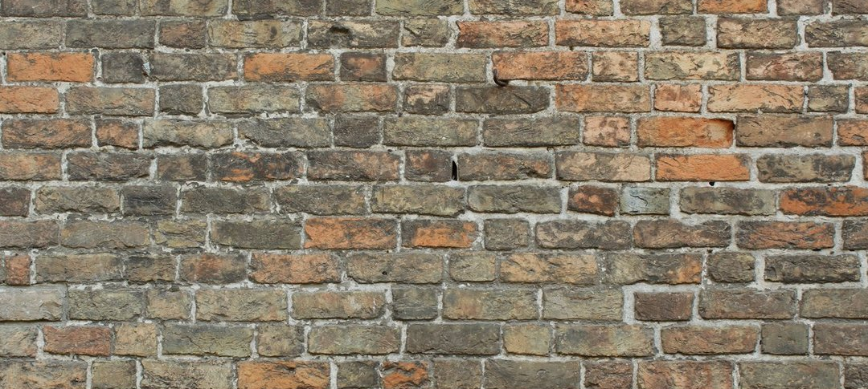
REAL TEXTURE – ROUGH

Slide 7
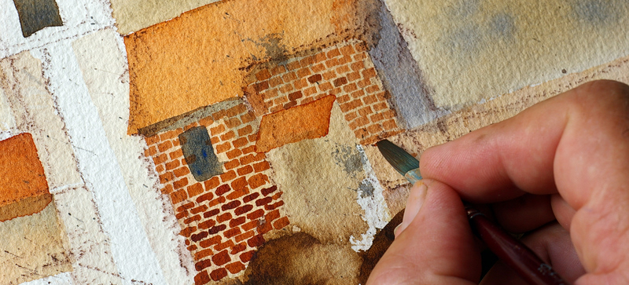
IMPLIED TEXTURE – ROUGH

Slide 8
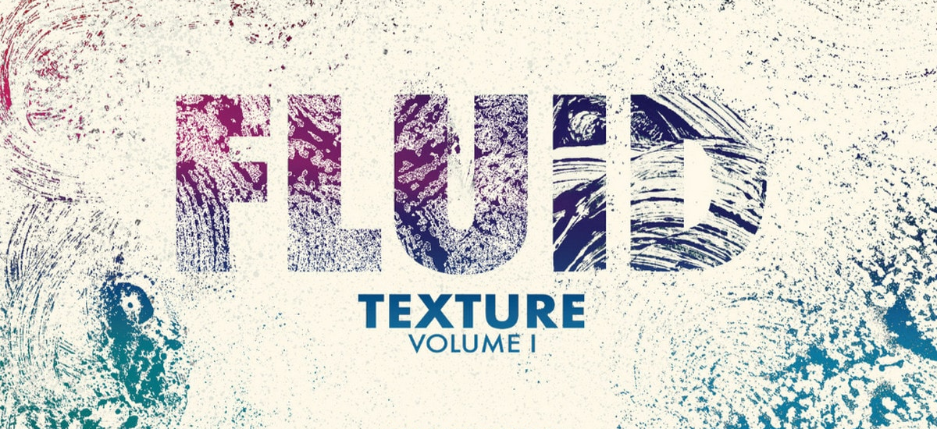
TEXTURE in Graphic Design – ROUGH

Slide 9
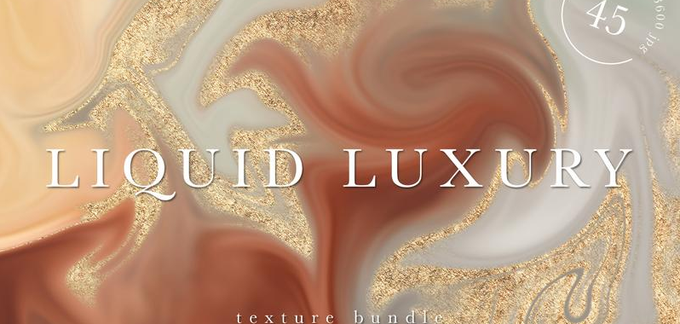
TEXTURE in Graphic Design – SMOOTH

