Slide 1
The Elements Of Art
the building blocks of art and design.

Slide 2
The Elements Of Art
SPACE refers to distances or areas around, between or within components of a piece.
Space can be positive (white or light) or negative (black or dark), open or closed, shallow or deep and two-dimensional or three-dimensional.
4. SPACE

Slide 3
The Elements Of Art
There are six ways to create the illusion of space on a 2-dimensional surface.
Overlapping Size Placement on the surface Detail Color and Value Linear Perspective
4. SPACE

Slide 4
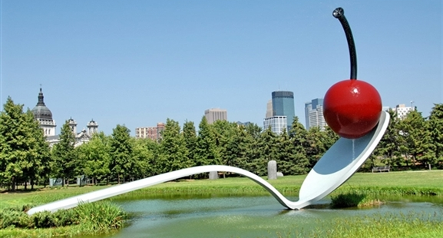
POSITIVE SPACE is the actual sculpture or building.

Slide 5
NEGATIVE SPACE is the space inside and around the sculpture or building.

Slide 6
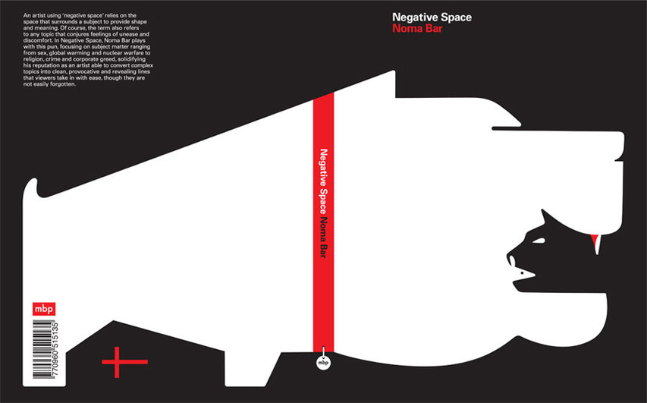
SPACE in Graphic Design Use of Negative Space

Slide 7
SPACE in Graphic Design Use of Negative Space

Slide 8
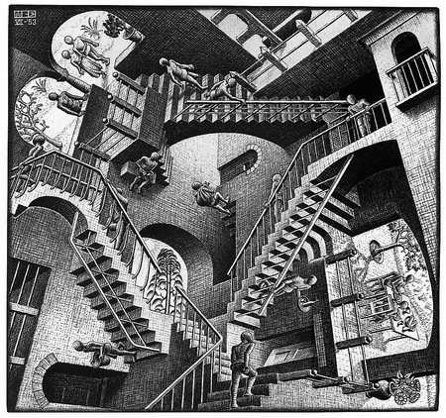
LINEAR PERSPECTIVE is the method of using lines to show the illusion of depth in a picture.

Slide 9
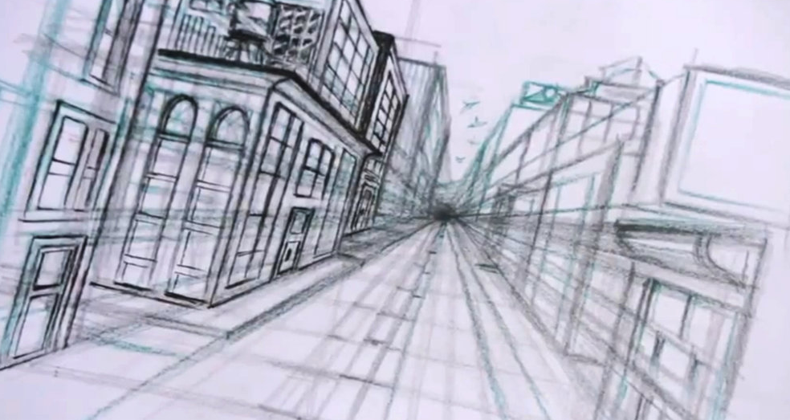
LINEAR PERSPECTIVE One point perspective uses one vanishing point to accomplish this illusion.

Slide 10
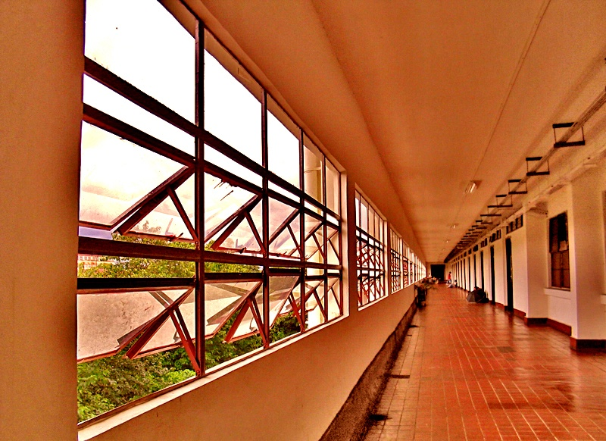
SPACE – One Point Perspective

Slide 11
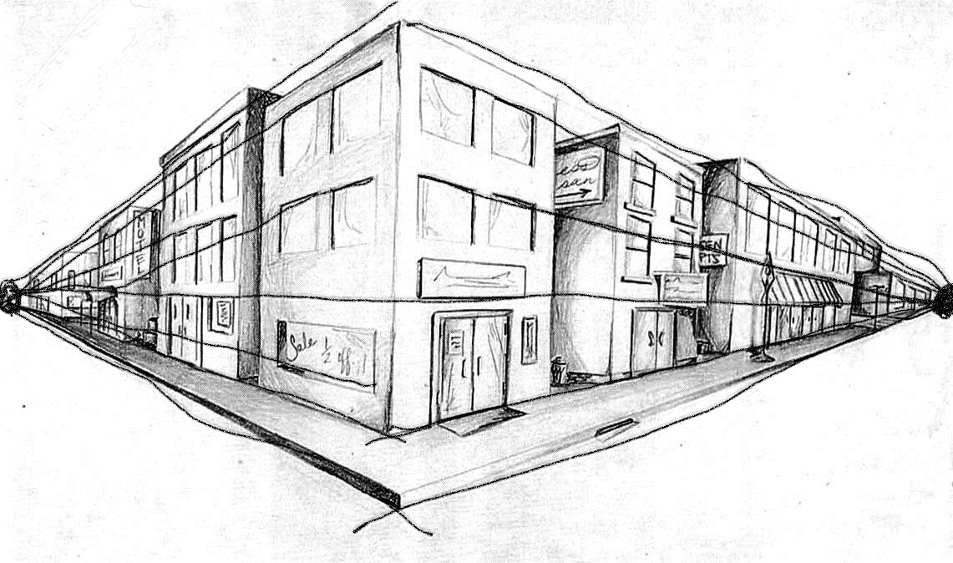
TWO POINT PERSPECTIVE - uses two vanishing points to create the illusion of space.

Slide 12
SPACE – Two point perspective

Slide 13
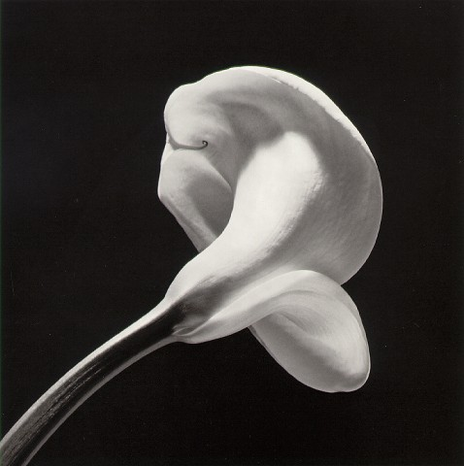
SPACE – Positive (filled with something). Negative (empty areas).

