Slide 1
The Elements Of Art
the building blocks of art and design.

Slide 2
The Elements Of Art
A SHAPE is an element of art. Specifically, it is an enclosed space
Shapes are limited to two dimensions: height and width.
2. SHAPE

Slide 3
The Elements Of Art
GEOMETRIC Shapes
Are man-made. You must use a tool such as a ruler, straight edge or compass to make this type of shape.
We see them in architecture and manufactured items.
Categories of Shape

Slide 4
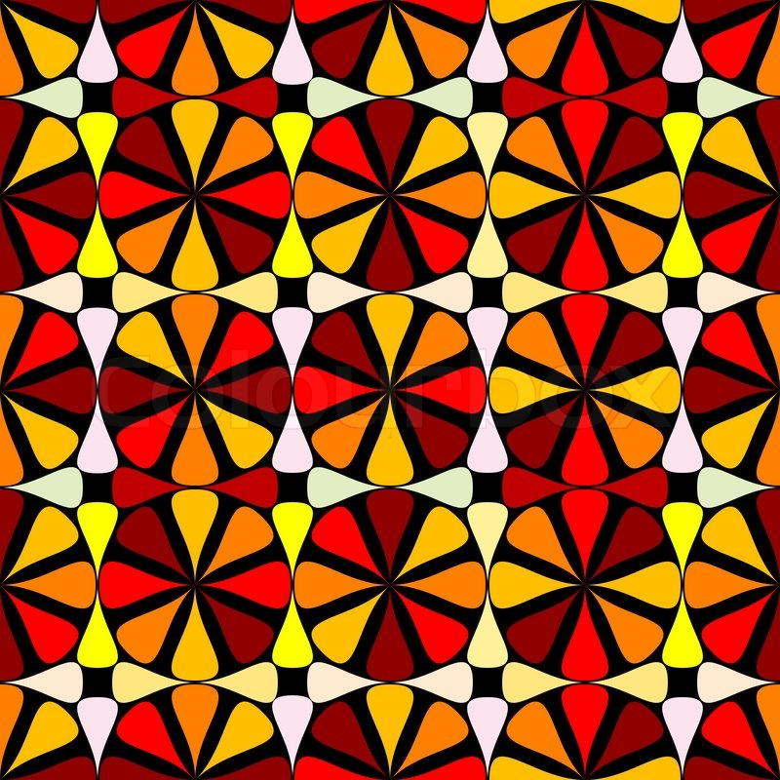
Geometric Shape
Circles, Squares, rectangles and triangles are examples of geometric shapes

Slide 5
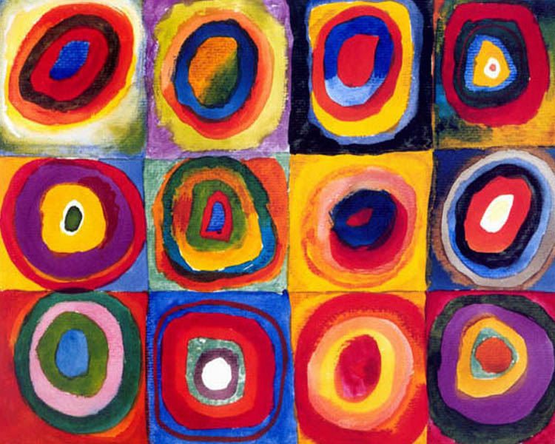
Geometric Shape in Art
Wassily Kandinski (1866 – 1944)
‘Concentric Circles'

Slide 6
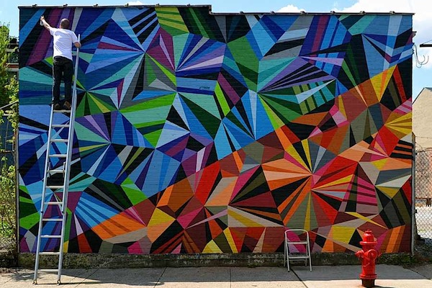
Geometric Shape in the Environment

Slide 7
Geometric Shape in Graphic Design

Slide 8
The Elements Of Art
ORGANIC Shapes
Are nature-made
We see them in nature and with characteristics that are free flowing, informal and irregular.
Categories of Shape

Slide 9
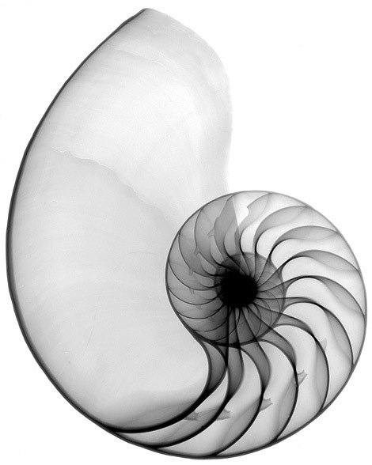
Organic Shape organic shapes found under water-shaped, sculpted and cultivated. These are perfect natural beauties.

Slide 10
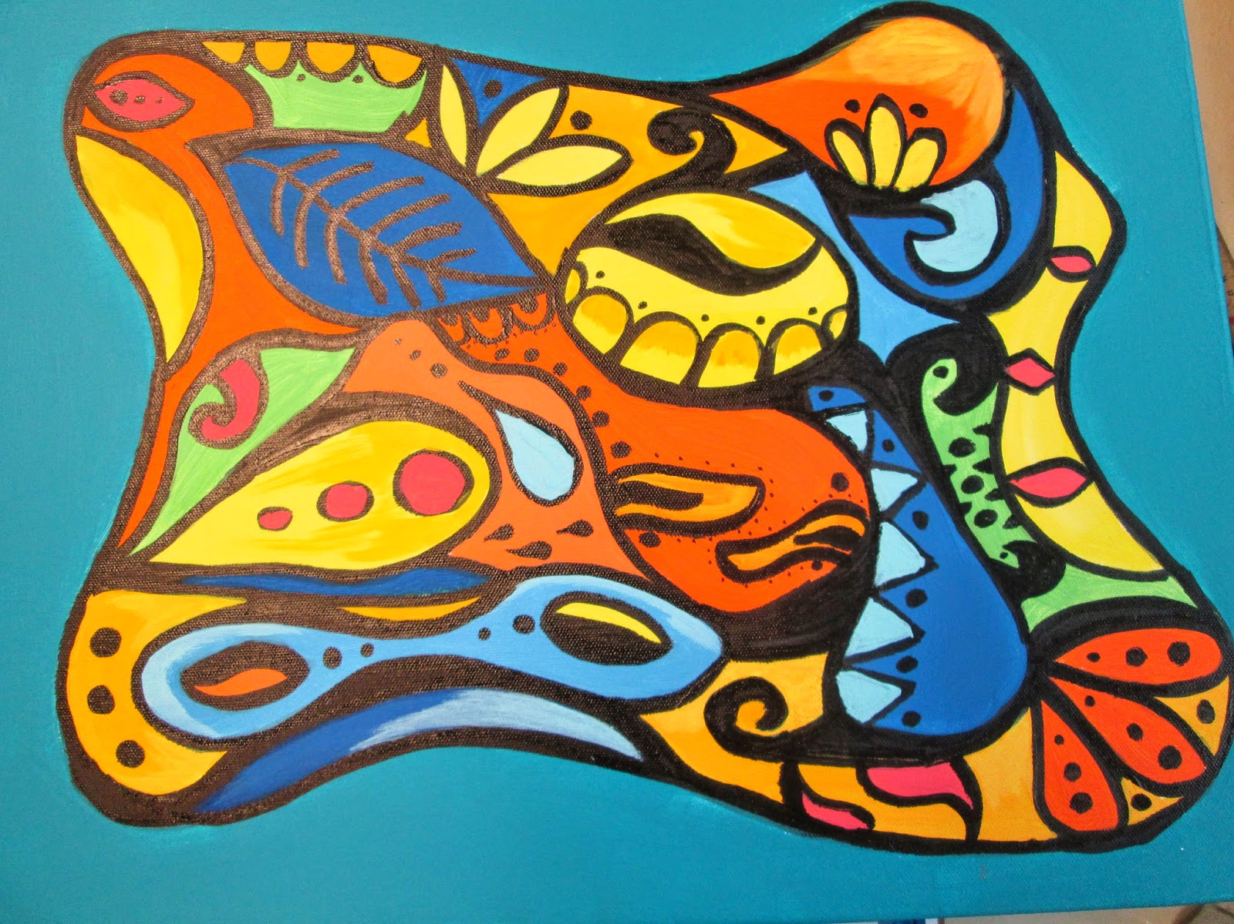
Organic Shape Organic shapes are natural looking and flowing shapes. They are more rounded and curved in appearance.

Slide 11
Organic Shape in Graphic Design

