Slide 1
The Elements Of Art
the building blocks of art and design.

Slide 2
The Elements Of Art
An element of art is simply a component, like a tool, that the artist uses to accomplish what he/she sets out to create.

Slide 3
The Elements Of Art
There are a variety of elements which work together to help the artist express an idea or feeling. The question is, do you see them?
When looking at works of art…..

Slide 4
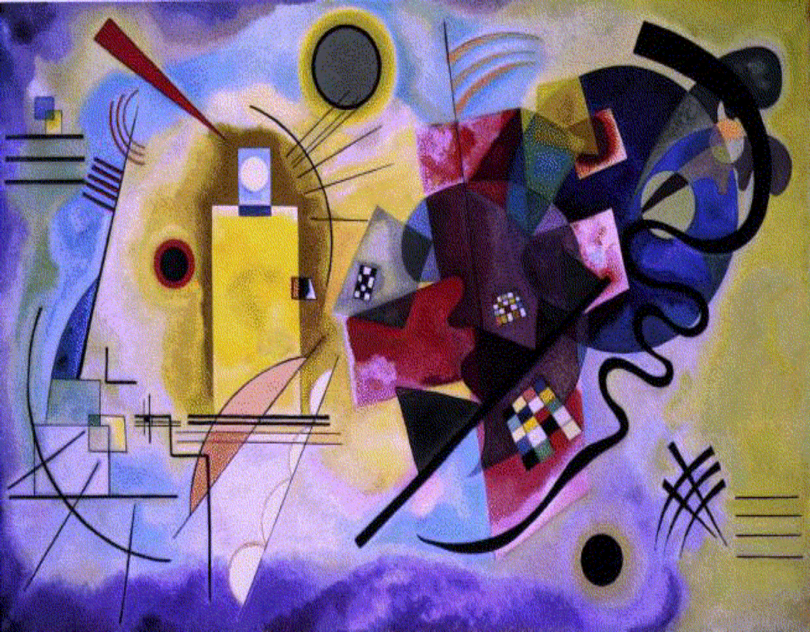
you see different COLORS,
Kandinsky – Yellow Red Blue, 1925. Place of Creation: Dessau-alten, Germany.

Slide 5
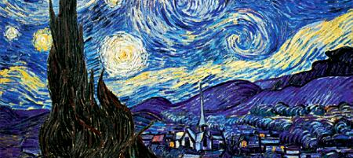
you see different VALUES,
Vincent van Gogh. The Starry Night. Saint Rémy, June 1889

Slide 6
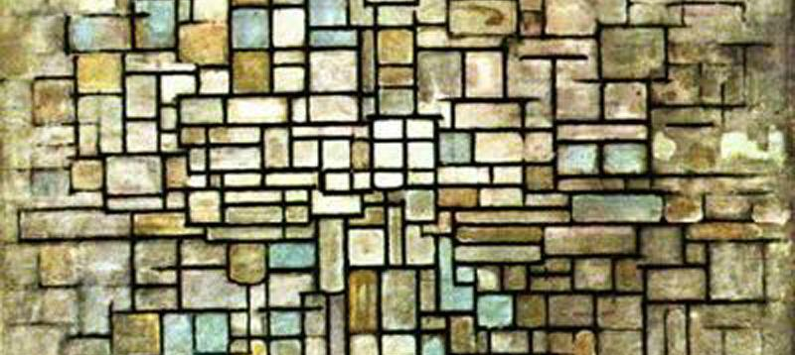
you see different LINES,
Composition in Blue, Grey and Pink by Piet Mondrian (1872-1944, Netherlands

Slide 7
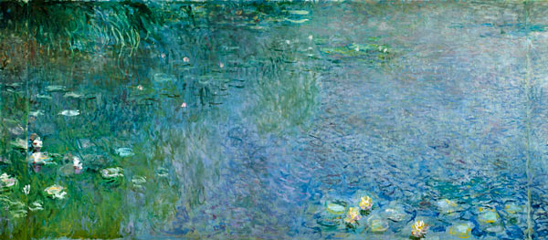
you see different TEXTURES
Monet, Claude : Waterlilies: Morning. Impressionism.

Slide 8
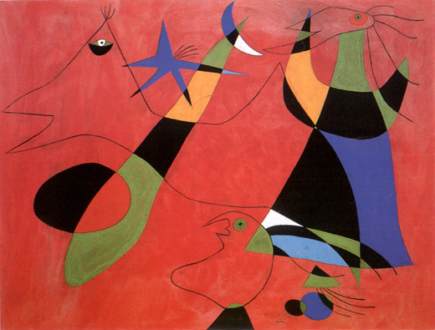
and SHAPES.
Joan Miró,
figures on a red background, 1939

Slide 9
The Elements Of Art
You see countless ways artists combine and organize these elements so their ideas and feelings can be communicated and understood by viewers.

Slide 10
The Elements Of Art
To fully understand a painting, a sculpture, or a building, you need to understand a visual vocabulary and recognize how it is used to produce successful works of art, or in our case, designs.

Slide 11
The Elements Of Art
LINE
SHAPE
SPACE
TEXTURE
VALUE
FORM
COLOR
There are Seven Elements of Art:

Slide 12
The Elements Of Art
The path of a point moving through space is a LINE.
A line is the most basic element of art, and is absolutely essential in creating art.
Lines may be explicit or implied.
1. LINE

Slide 13
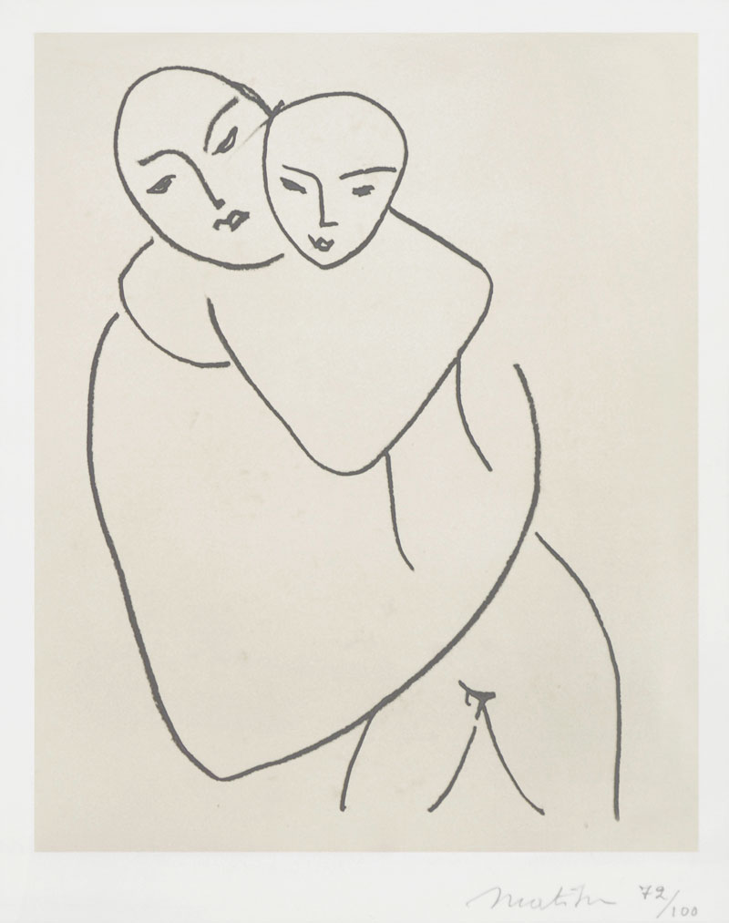
Line - explicit
Henri Matisse
Madonna and Child · 1950 - 1951

Slide 14
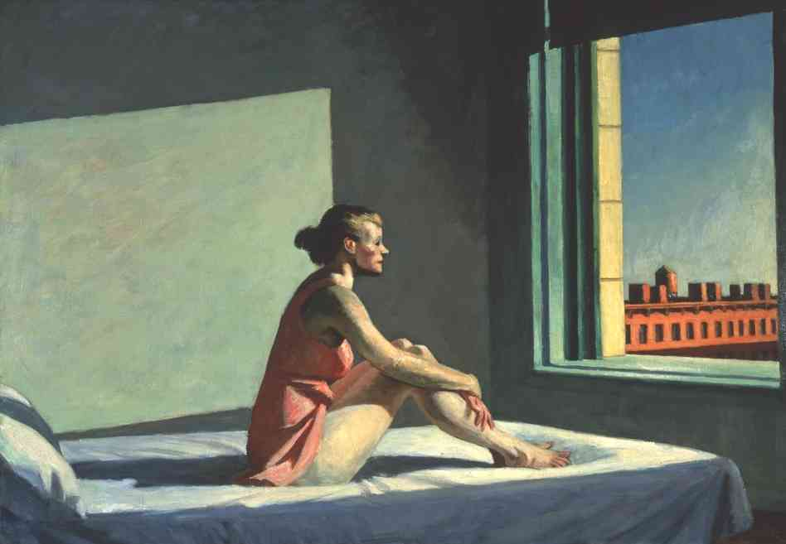
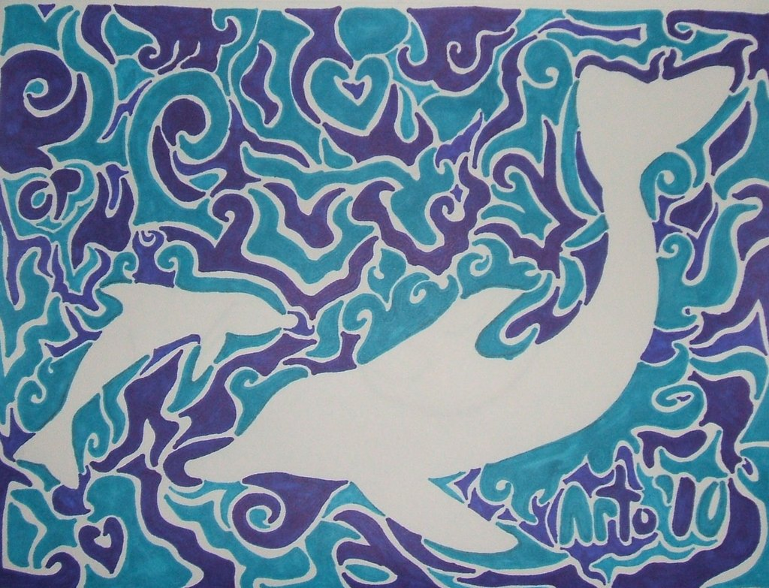
Line - implied

Slide 15
The Elements Of Art
WIDTH
Characteristics of a Line
Thick
Thin
Tapering

Slide 16
The Elements Of Art
LENGTH
Long
Short
Continuous
Broken
Characteristics of a Line

Slide 17
The Elements Of Art
DIRECTION Horizontal Vertical Diagonal Curvilinear Perpendicular Parallel Zigzag
Characteristics of a Line

Slide 18
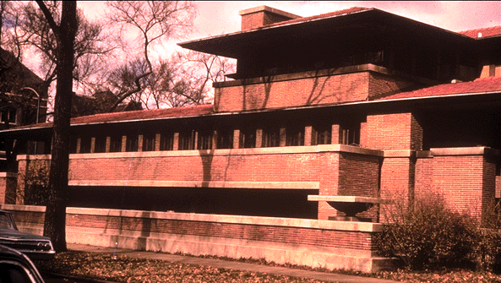
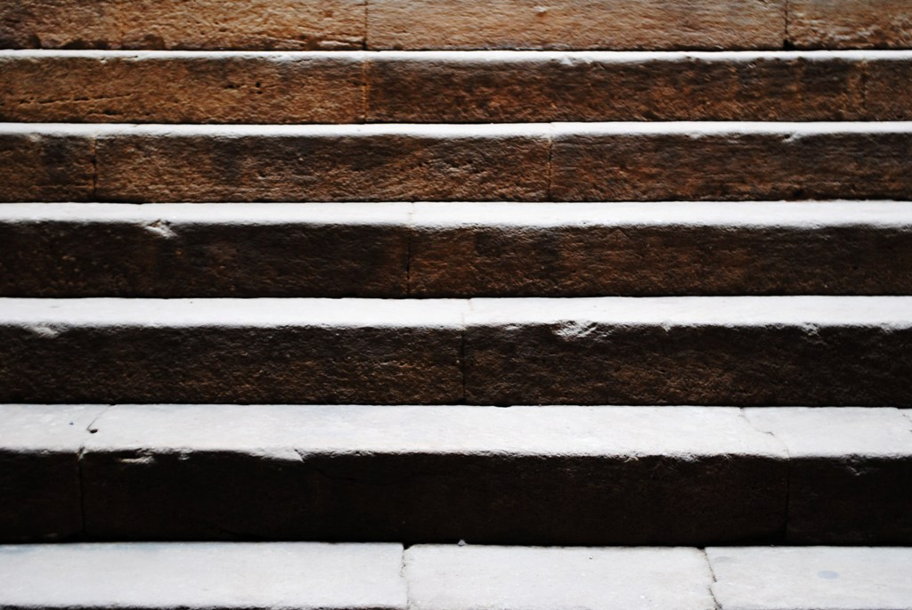
HORIZONTAL LINE suggests a feeling of rest or repose. Objects parallel to the earth are at rest in relation to gravity. Therefore compositions in which horizontal lines dominate tend to be quiet and restful in feeling. One of the hallmarks of Frank Lloyd Wright's architectural style is its use of strong horizontal elements which stress the relationship of the structure to the land.

Slide 19
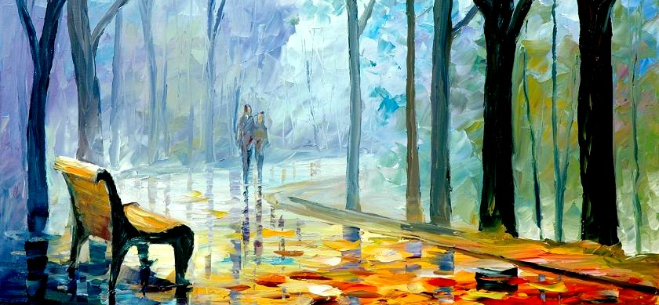
VERTICAL LINES communicate a feeling of loftiness and spirituality. Vertical lines seem to extend upwards beyond human reach, toward the sky. They often dominate public architecture, from cathedrals to corporate headquarters. Extended perpendicular lines suggest an overpowering grandeur, beyond ordinary human measure.

Slide 20
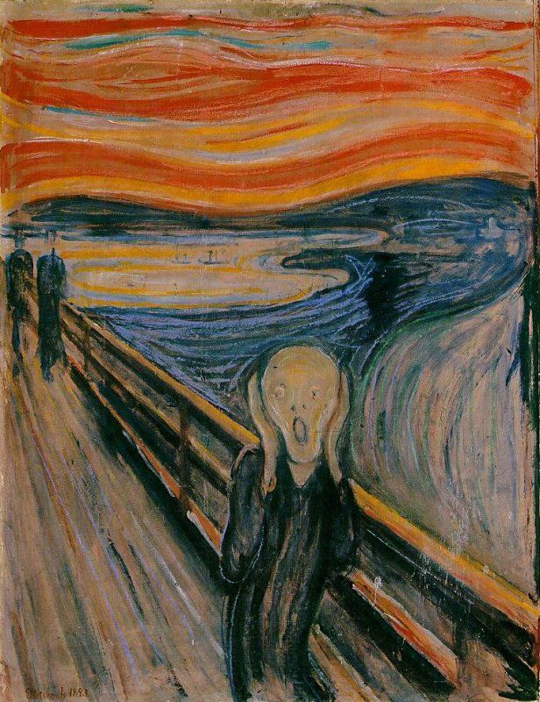
DIAGONAL LINE
Eduard Munch used the diagonal line in “The Scream” to bring our eye to the subject.

Slide 21
CURVILIEAR LINE
Curvilinear line create a flowing movement which creates a sense of movement.

Slide 22
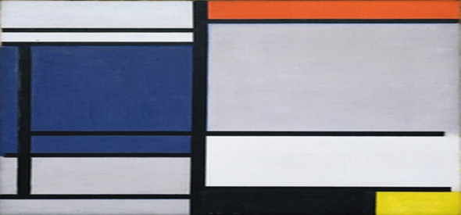
PERPENDICULAR LINE
Lines that are intersecting at 90º to each other.
Perpendicular lines create tension in the design.

Slide 23
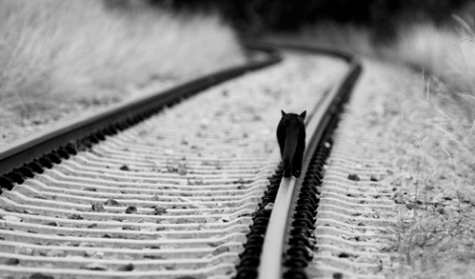
PARALLEL LINE
Parallel lines create a synergy or unity in the design.

Slide 24
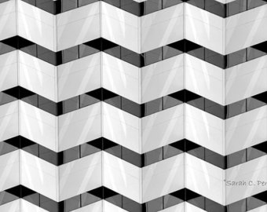
ZIGZAG LINE
An angular shape characterized by sharp turns in alternating directions.
In this example we get a sense of depth or dimension

Slide 25
The Elements Of Art
TEXTURE Jagged
Graceful
Characteristics of a Line

Slide 26
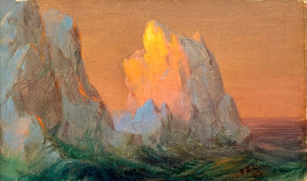
JAGGED LINE
A line with a sharply uneven surface or outline

Slide 27
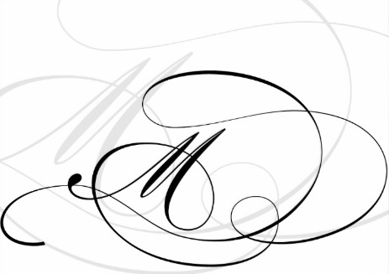
GRACEFUL LINE
The graceful line creates a soft, gentle, elegant feeling.

Slide 28
The Elements Of Art
EMOTION
Anger, Joy, Sad, Excitement
Characteristics of a Line

Slide 29
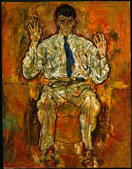
This artist used an uneven outline with thick and thin, curved and jagged lines to suggest the nervous energy of his subject.

Slide 30
The Elements Of Art
Outlines- Lines made by the edge of an object or its silhouette.
Contour Lines- Lines that describe the shape of an object and the interior detail.
Expressive Lines- Line that are energetic and catches the movement and gestures of an active figure.
Types of Line

Slide 31
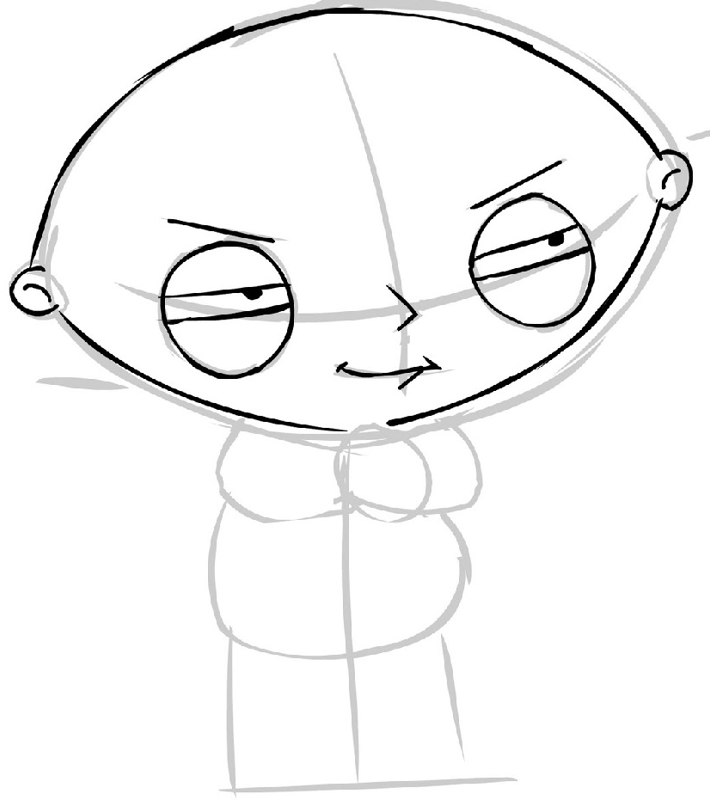
OUTLINE
Lines made by the edge of an object or its silhouette. Defines the general shape

Slide 32
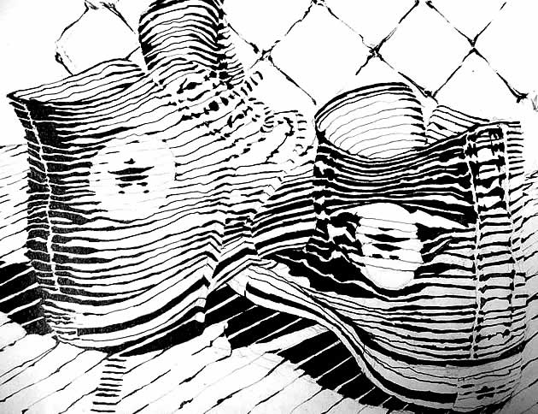
CONTOUR LINE
Define or create the dramatic changes of plane within a form

Slide 33
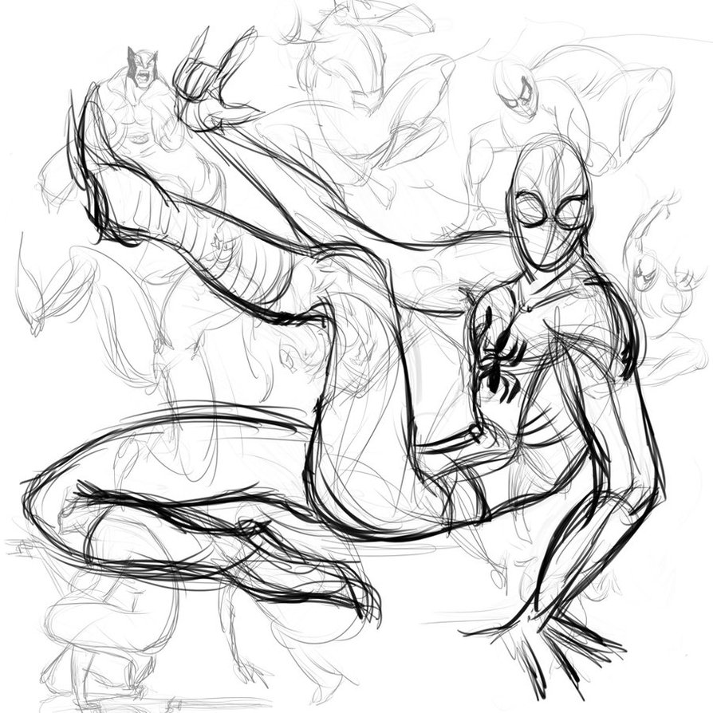
GESTURE LINE
Line that are energetic and catches the movement and gestures of an active figure.

Slide 34
LINE in Graphic Design

