Slide 1
The Elements Of Art
the building blocks of art and design.

Slide 2
The Elements Of Art
All forms first begin with a shape.
On a flat surface, an artist will create the illusion of a 3 dimensional form through the use of value (shading) and space.
3. FORM

Slide 3
The Elements Of Art
A shape is 2-dimensional; it has only height and width
A form is 3-dimensional: it has height, width and DEPTH
3. FORM

Slide 4
The Elements Of Art
The Elements Of Art
Form
Square Cube
Triangle Pyramid
Rectangle Cylender
Circle Sphere

Slide 5
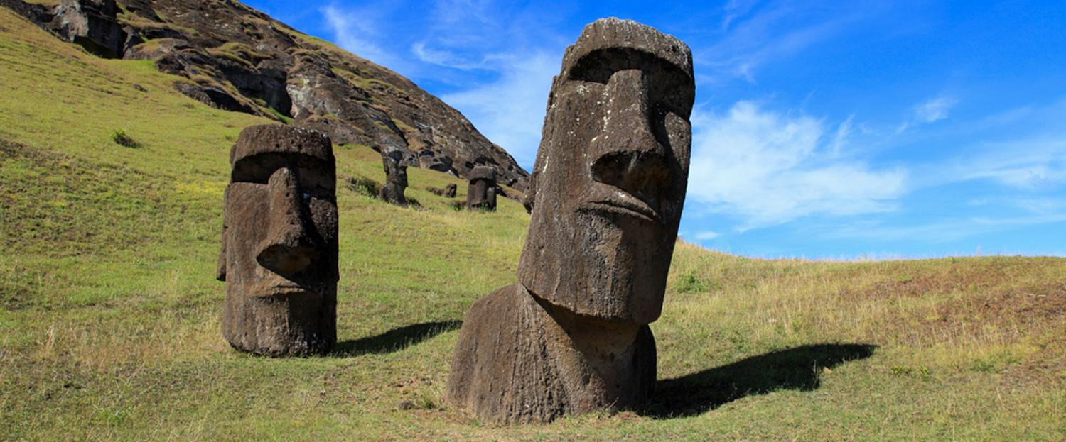
FORM The Easter Island statues may have been created in the image of various paramount chiefs. They were not individualized portrait sculptures, but standardized representations of powerful individuals.

Slide 6
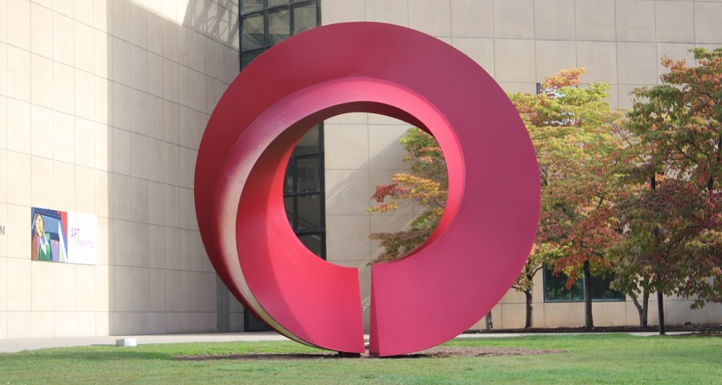
FORM PAGE by Erik Deckers - Sculpture outside the IU Art Museum.

Slide 7
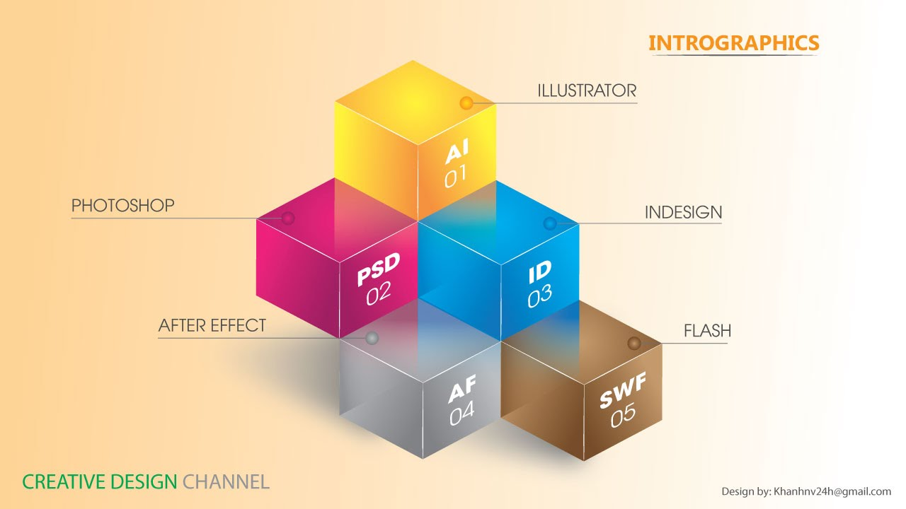
FORM in Graphic Design Simulated

Slide 8
FORM in Graphic Design Actual

