Slide 1
The Elements Of Art
the building blocks of art and design.

Slide 2
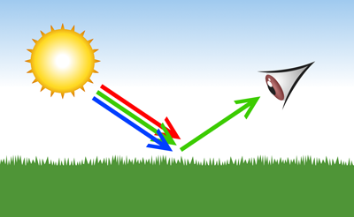
The Elements Of Art
7. COLOR
COLOR is the element of art that is produced when light, striking an object, is reflected back to the eye.

Slide 3
The Elements Of Art
There are three (3) properties to color.
First is HUE, which simply means the name we give to a color (red, yellow, blue, etc.)
7. COLOR

Slide 4
The Elements Of Art
The second property is INTENSITY, which refers to the strength and vividness of the color.
For example, we may describe the color blue as "royal" (bright, rich, vibrant) or "dull" (grayed).
7. COLOR

Slide 5
The Elements Of Art
The third and final property of color is its VALUE, meaning its lightness or darkness.
The terms SHADE and TINT are in reference to value changes in colors.
7. COLOR

Slide 6
The Elements Of Art
Categories of
Color
The Color Wheel is a tool used to organize color. Within it, there are 3 divisions of color.

Slide 7
The Elements Of Art
Color Wheel
Primary
Secondary
Primary
Secondary
Secondary
Primary
Tertiary
Tertiary
Tertiary
Tertiary
Tertiary
Tertiary
The Color Wheel

Slide 8
The Elements Of Art
Categories of
Color
The Color Wheel is a tool used to organize color.
Within it, there are 3 divisions of color.

Slide 9
PRIMARY – Red, Yellow, Blue
You can not mix colors to get any one of these primary colors

Slide 10
SECONDARY COLORS - Orange, Violet, Green
These colors are created by mixing two primaries.

Slide 11
TERTIARY COLORS - Red Orange, Yellow Green, Blue Violet, etc.; mixing a primary with a secondary creates these colors.

Slide 12
The Elements Of Art
The Color Wheel is a tool used to organize color.
Within it, there are color groups.
Color
Groups

Slide 13
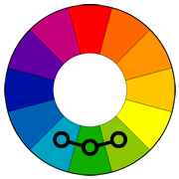
ANALOGOUS COLORS - The analogous colors are those colors which lie on either side of any given color, and who share a common color. In this example, they share green.

Slide 14
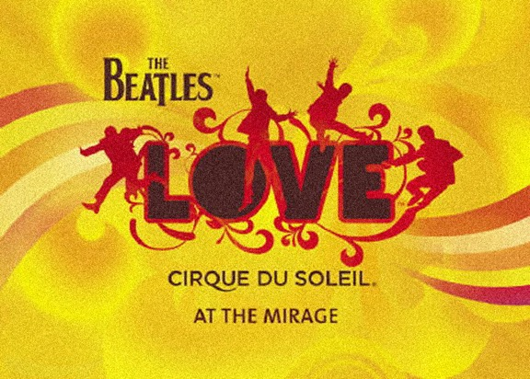
ANALOGOUS COLORS in Graphic Design

Slide 15
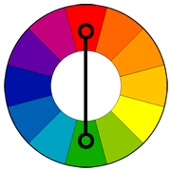
COMPLIMENTARY COLORS - are colors that are opposite each other on the color wheel. When placed next to each other they look bright and when mixed together they neutralize each other.

Slide 16
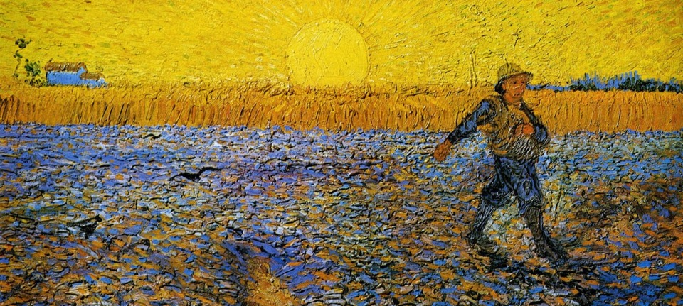
COMPLIMENTARY COLORS

Slide 17
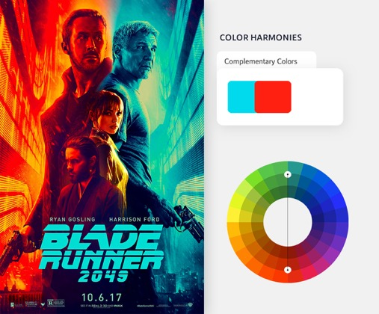
COMPLIMENTARY COLORS in Graphic Design

Slide 18
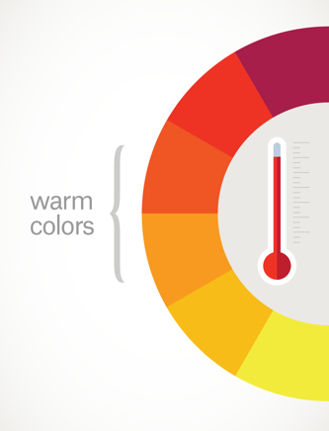
WARM COLORS - are on one side of the color wheel and they give the felling of warmth for example red, orange and yellow are the color of fire and feel warm.

Slide 19
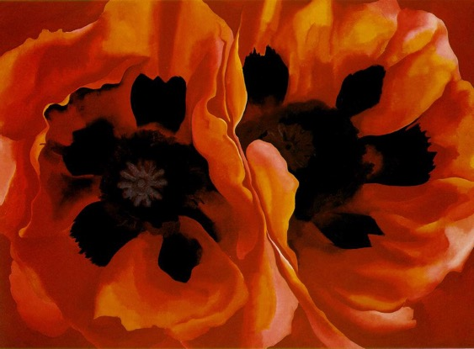
WARM COLORS - Geogria O’Keefe – POPPIES (1928)

Slide 20
WARM COLORS - Geogria O’Keefe – POPPIES (1928)

Slide 21
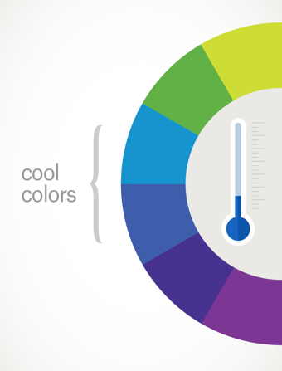
COOL COLORS - are on the other side of the color wheel and they give the feeling of coolness for example blue, violet, are the color of water, and green are the color of cool grass.

Slide 22
COOL COLORS
Mark Kotsabi - The School of Athens (Scuola di Atene)

Slide 23
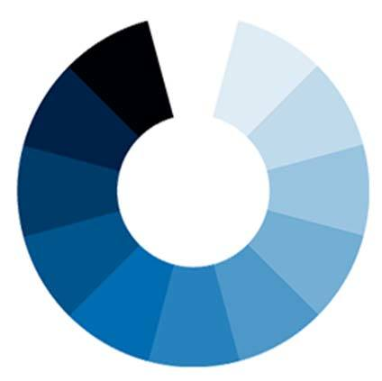
MONOCHROMATIC Harmony – A monochromatic object or image has colors in shades of limited colors or hues.

Slide 24
MONOCHROMATIC Harmony A monochromatic object or image has colors in shades of limited colors or hues.

Slide 25
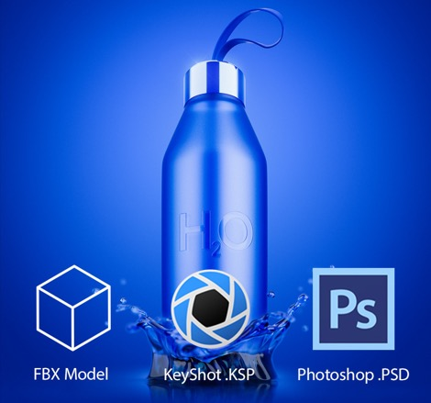
MONOCHROMATIC in Graphic Design

