Slide 1
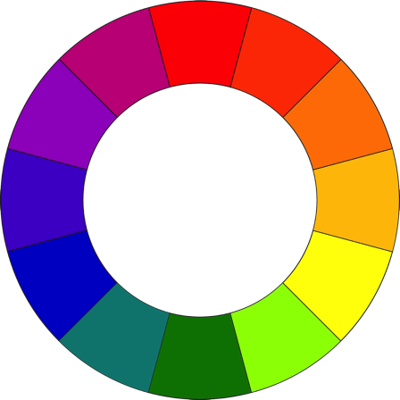
THE COLOR WHEEL
Colors affect us in numerous ways, both mentally and physically. A strong red color has been shown to raise the blood pressure, while a blue color has a calming effect.
Being able to use colors harmoniously can help us create spectacular results.
The color wheel is a diagram or tool that is used by an artist to help make color selections or color schemes for an artwork.

Slide 2
CATEGORIES OF COLOR
PRIMARY
TERTIARY
TERTIARY
Primary
Red, Yellow, Blue
These colors cannot be made. These colors will make ALL of the other colors on the wheel.
Example: R + Y = O
Secondary
Orange, Violet, Green
These colors are created by mixing two primaries in equal proportions.
Tertiary / Intermediate
Red Orange, Yellow Green, Blue Violet, etc.;
Mixing a primary with a secondary in equal portions creates these colors.
SECONDARY
SECONDARY
TERTIARY
TERTIARY
PRIMARY
PRIMARY
TERTIARY
TERTIARY
SECONDARY

Slide 3
CATEGORIES OF COLOR
PRIMARY
The Primary Colors
are considered the most basic colors in the color wheel, these are called primary because they can make all of the other
colors on the color wheel and because
it is not possible to create these colors
out of other colors.
The Primary Colors are:
PRIMARY
PRIMARY

Slide 4
CATEGORIES OF COLOR
The Secondary Colors
these 3 colors are made by combining
two primary colors together
in equal portions.
The secondary colors are:
SECONDARY
SECONDARY
SECONDARY

Slide 5
CATEGORIES OF COLOR
TERTIARY
TERTIARY
The Tertiary Colors
These are the colors that are made by mixing a primary and A secondary color in equal portions.
TERTIARY
TERTIARY
TERTIARY
TERTIARY

Slide 6
CATEGORIES OF COLOR
The Neutrals
are non-colors; they are Black,
White, Grey
and sometimes Brown
BLACK
WHITE
GREY
BROWN

Slide 7
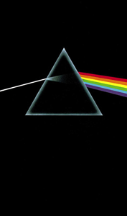
CATEGORIES OF COLOR
Prism
In a famous experiment over 300 years ago, Isaac Newton demonstrated that when a beam of light is passed through a glass object, called a prism, the light divides into the 7 colors of the rainbow, each one of these represents a different ray of light.

Slide 8
CATEGORIES OF COLOR
Hue
identifies a color as blue, green, yellow, and so on…it is another name for color.
Color Intensity
Is the brightness or dullness of a color. If the color is intense, this means that it is very bright.
Color Value
Every color has a normal value as seen on the color wheel. The value of a color can be changed to dark or light by adding a neutral of white or black.

Slide 9
CATEGORIES OF COLOR
Tint
Is any color plus the neutral white. Tints are made by adding white to a color, to lighten up the value of the hue.
Shade
Is any color plus the neutral black. Shades are made by adding black to a color to lighten up the value of the hue.
Color Value Scale
Is the same as a value scale except you begin with the true hue in the middle then darken the scale by making shades to the right, and lightening the scale by making tints to the left.

Slide 10
Monochromatic Color
Monochromatic
“Mono” means one and “Chroma” means color.
Monochromatic color schemes have only one color and its’ values, made from tints and shades of the same color.

Slide 11
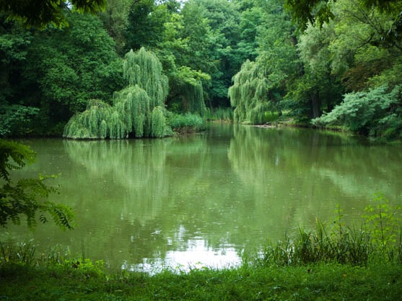

Slide 13
MONOCHROMATIC Harmony A monochromatic object or image has colors in shades of limited colors or hues.

Slide 14
Complimentary Colors
PRIMARY
TERTIARY
TERTIARY
are colors that are directly opposite each other on the color wheel. When put side by side these will colors will seem to be the most intense (or bright).
But when mixed together the colors will cancel the others intensity, they will “neutralize” each other when mixed together.
The high contrast of complementary colors creates a vibrant look especially when used at full saturation.
Complementary color schemes are tricky to use in large doses, but work well when you want something to stand out.
SECONDARY
SECONDARY
TERTIARY
TERTIARY
PRIMARY
PRIMARY
TERTIARY
TERTIARY
SECONDARY

Slide 15
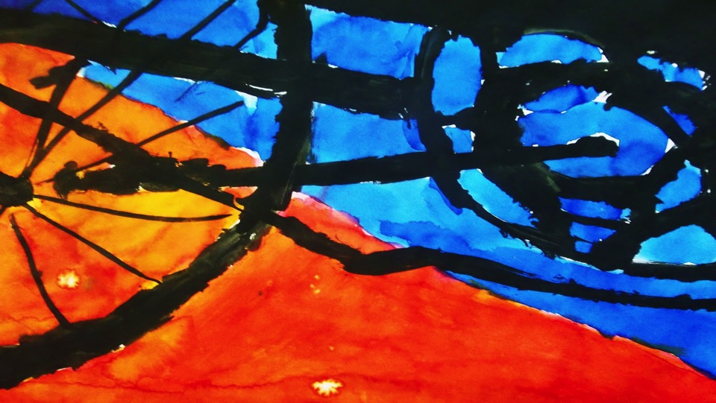

Slide 16
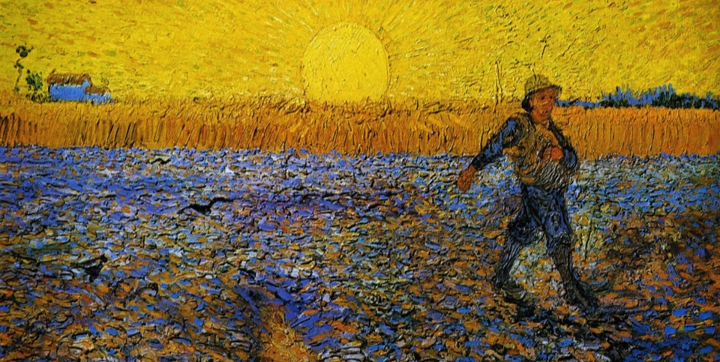

Slide 17
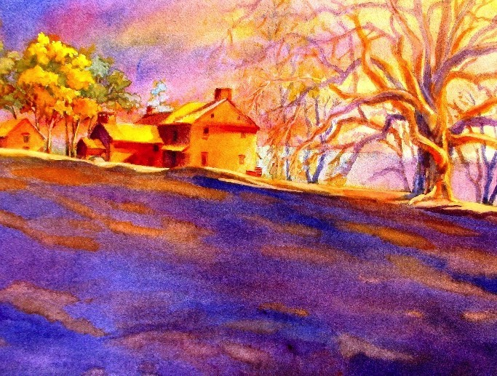

Slide 18
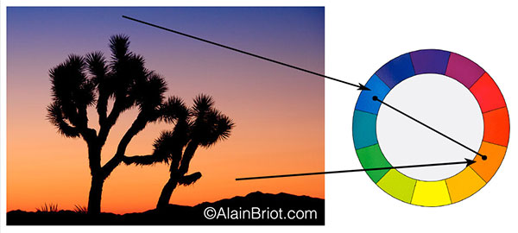

Slide 20
Analogous Colors
YELLOW
YELLOW ORANGE
YELLOW GREEN
ORANGE
GREEN
Analogous color schemes use colors that are next to each other on the color wheel, and with at least one color in common.
RED ORANGE
BLUE GREEN
RED
BLUE
RED VIOLET
BLUE VIOLET
VIOLET

Slide 21
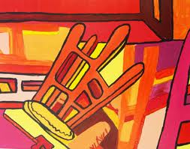

Slide 24
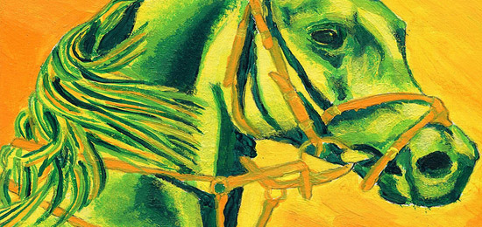

Slide 25
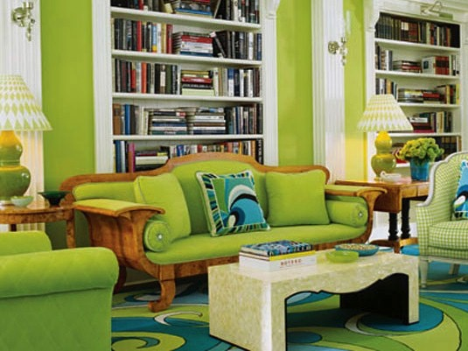

Slide 28
Color Temperature
YELLOW
YELLOW ORANGE
YELLOW GREEN
Warm colors
are color schemes with reds, yellows, and oranges. Warm colors will seem to appear closer than cool colors in a painting or drawing, they will seem to advance in space.
Warm colors are sometimes associated with love, passion, compassion, empathy, fire,
heat, anger, to name a few.
ORANGE
GREEN
RED ORANGE
BLUE GREEN
RED
BLUE
RED VIOLET
BLUE VIOLET
VIOLET

Slide 29
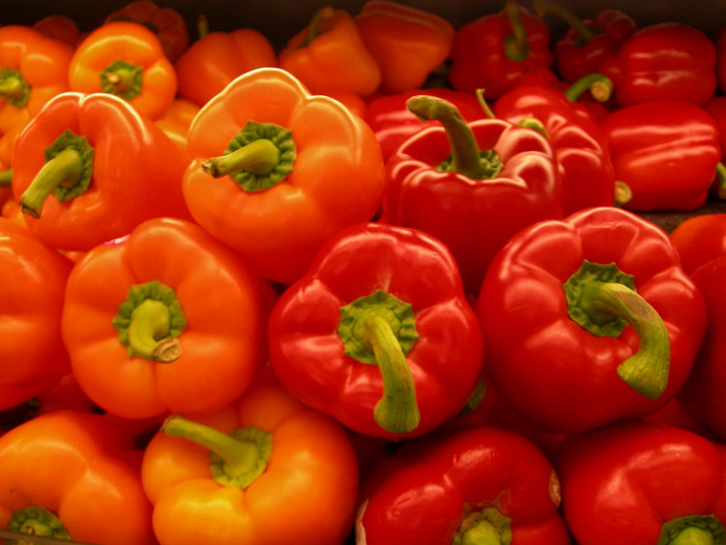
WARM COLORS

Slide 30
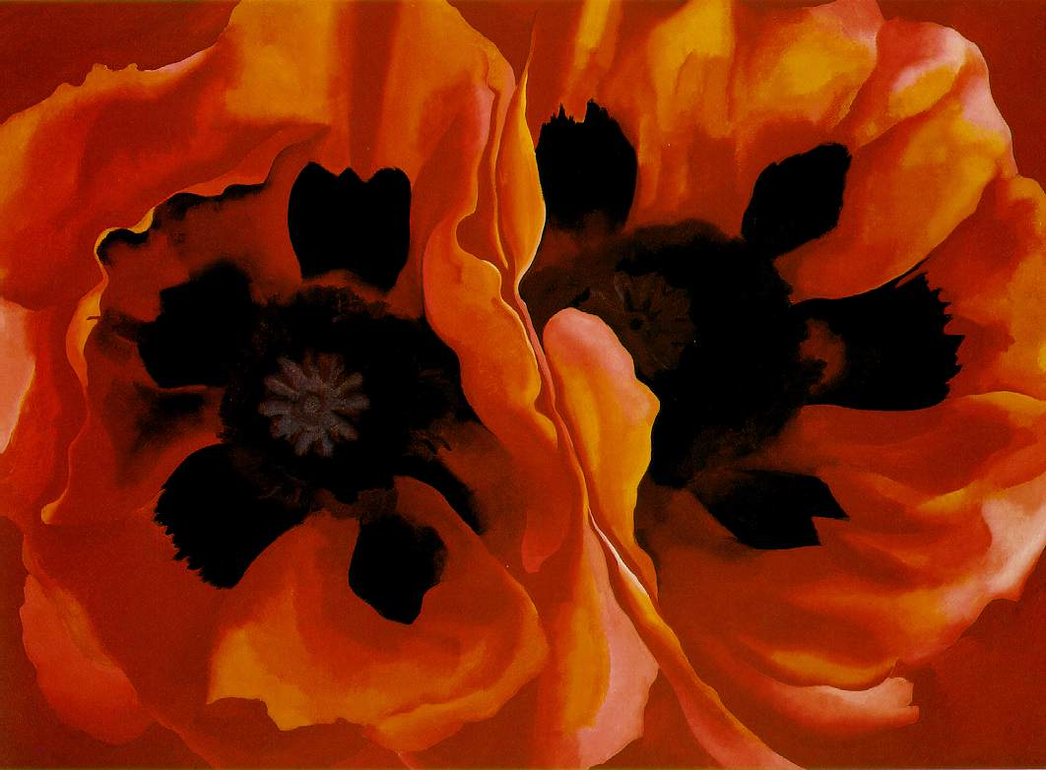
WARM COLORS
Geogria O’Keefe – POPPIES (1928)

Slide 31
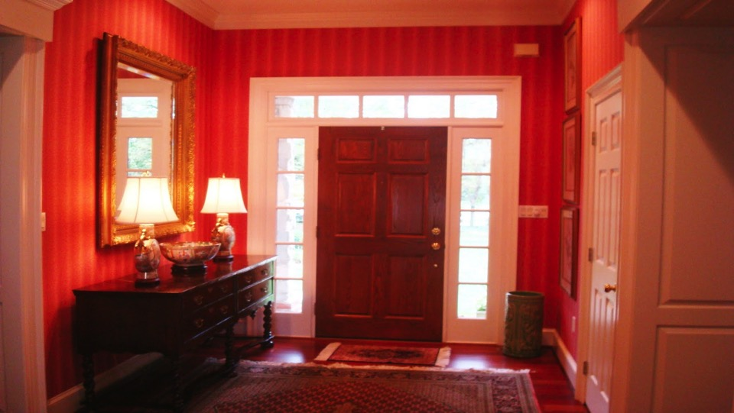

Slide 32
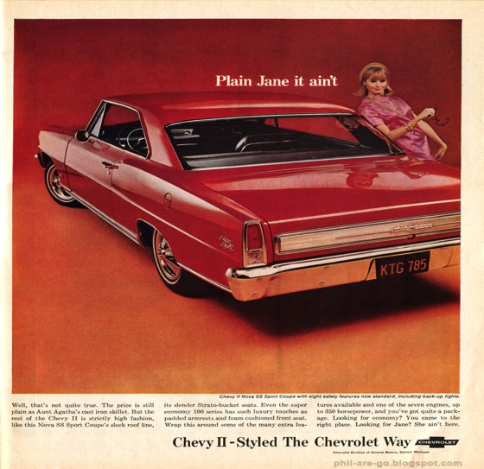
The Chevy is red. Ad men know that red means excitement, danger, adventure, and fun - everything young people want in a car. The art director for this ad included colors that are neighbors to red on the color wheel (analogous).
This keeps the ad nice and "hot". Orange, pink, red.

Slide 33
Color Temperature
YELLOW
YELLOW ORANGE
YELLOW GREEN
ORANGE
GREEN
Cool colors are on the other side of the color wheel and they give the feeling of coolness.
For example, blue is the color of water, and green is the color of cool grass.
RED ORANGE
Cool colors
BLUE GREEN
RED
BLUE
RED VIOLET
BLUE VIOLET
VIOLET

Slide 34
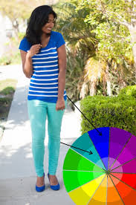
Color Temperature
Cool colors can also be analogous.
In this example, we see how we can use the color wheel to make whatever color choices we need to make, either when we are designing….. Or just getting dressed for the day!

Slide 35
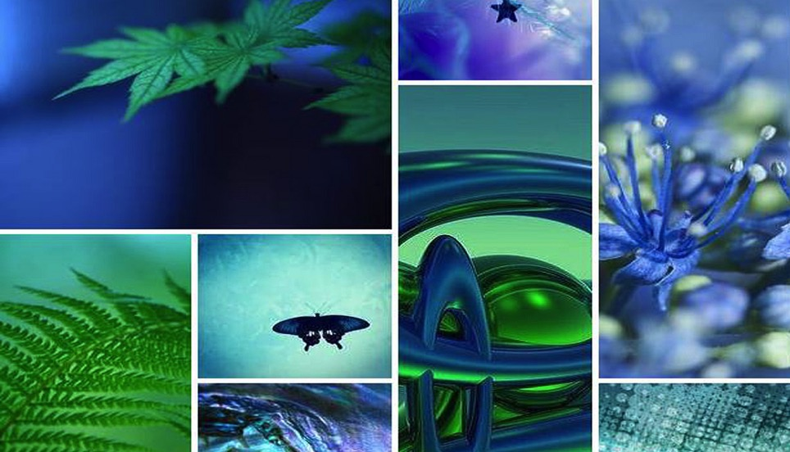

Slide 36
