Slide 1
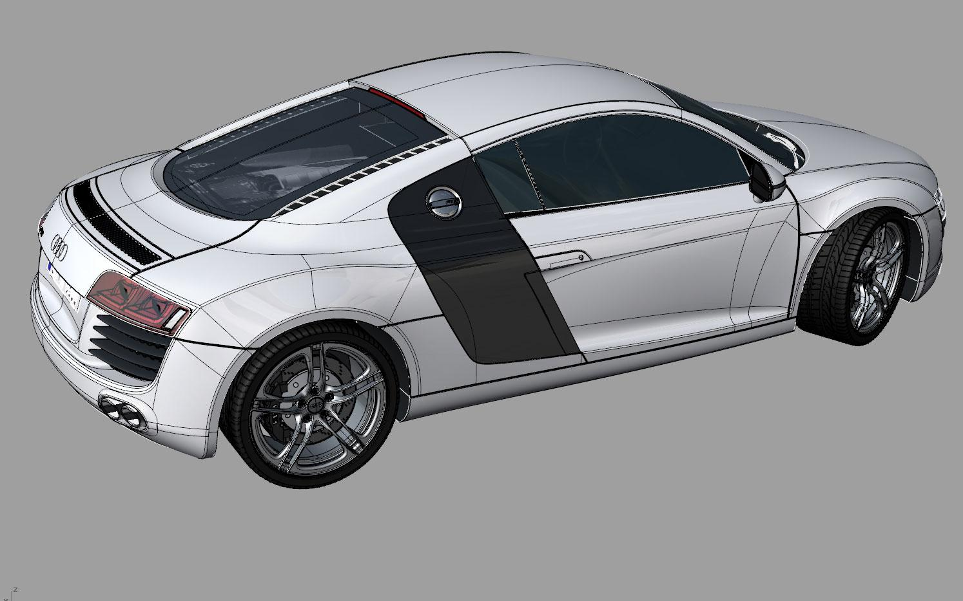
3D Animations
Ruben Sierra
P.4

Slide 2
skills to be a 3D animator
-To be an animator you have to be creative with your work by making your own animations with lots of detail.
- Another skill that animators need are computer programing skills so that they can create their own 3D animation programs or fix the the programs they have
- You have to be up to date with the trends in the animation field such as new software.

Slide 3
More skills
-In the field of computer animation it is sometimes very team based.
-You have to be able to communicate to others and be able to work as a team

Slide 4
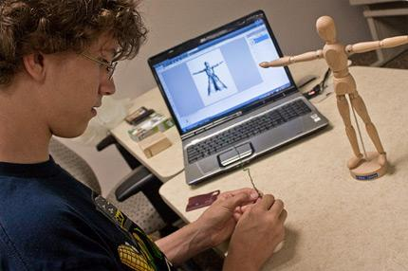

Slide 5
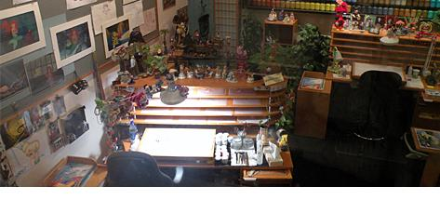
The desk of animators usually have small models of things they have created. They have various art supplies.

Slide 6
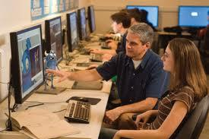
Animators will work most of the time in teams and collaborate with other teams.

Slide 7
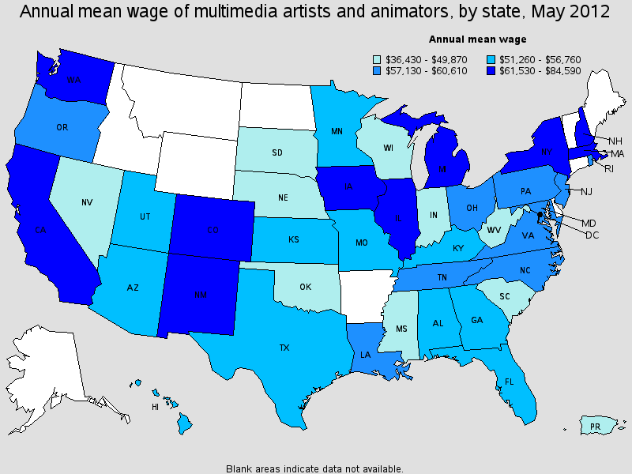

Slide 8
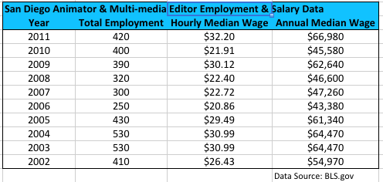
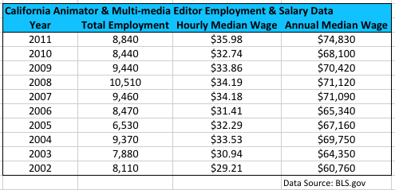

Slide 9
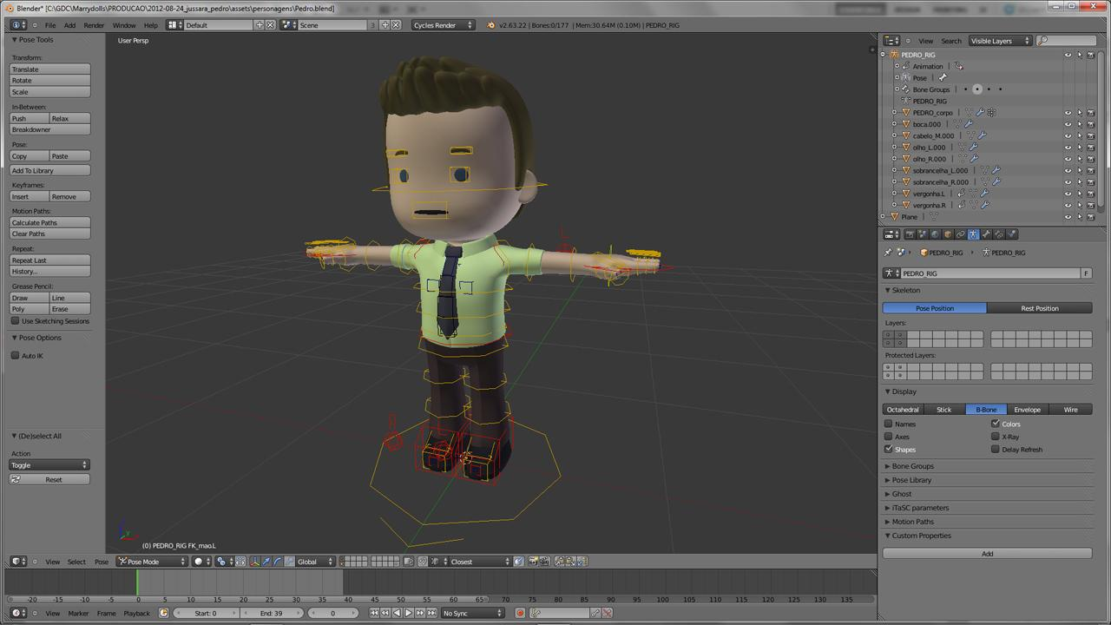
Animators will make drawings come to life on a screen, but first animators have to spend periods of time sketching and 3D modeling.

Slide 10
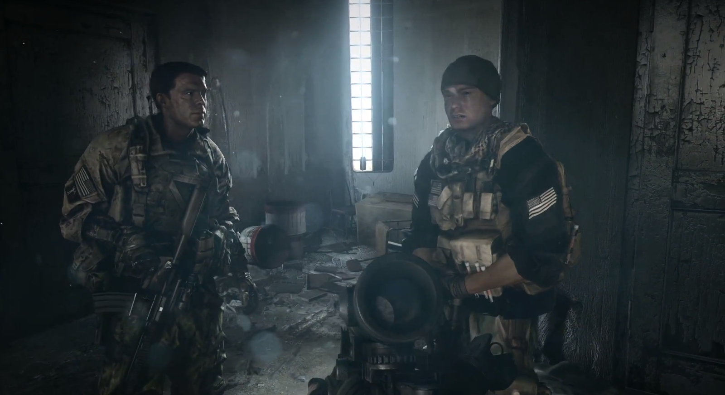
Animators play a huge role in the biggest video games out there. They produced some of the most detailed characters and sceens.

Slide 11
Qualifications
To become an animator you need at least a bachelors degree in art or design. Sometimes people with natural talent can get through but it is very rare, it is prefered by companies to have a degree in animation then just natural talent. Building a portfolio is also recommended to get a job.

Slide 12
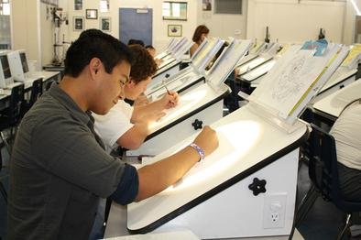
Animators go through a lot of training and a lot of trial and error. Animators have to do a lot of drawing before they even start on a computer.

Slide 13
These are some colleges for visual arts
-California Institute of The Arts
-USC
-School of Visual Arts NYC

Slide 14
animation unions
The Animation Guild-is located in hollywood and the animators that become members here can work for big animation companies such as Dreamworks animation and with Walt Disney animation Studios.
International Animated Film Association- is a international organization founded in 1960 in france by the best animation artist at that time.

Slide 15
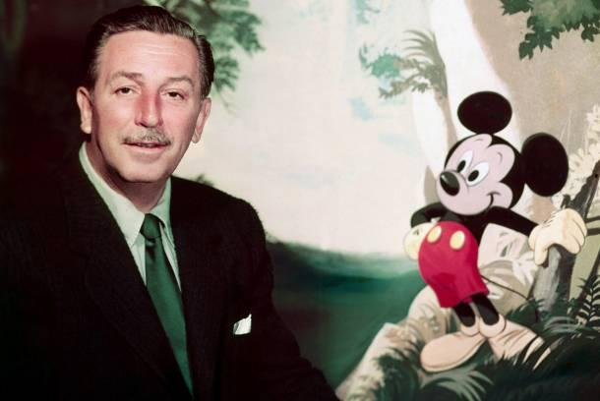
I think walt disney was a huge contributor to the world of animation.

Slide 16
He was born on December 5 1901 in Hermosa Illinois
He won 22 academy awards in his lifetime
He was the founder of Disneyland and walt Disney world
He died on december 15 1966

Slide 17
Walt Disney showed how far he could push his creativity and imagination. He was able to produce some of the most popular characters and films that are still seen today.

Slide 18
I chose this occupation because its something I may want to do as a career and its better than having an ordinary job where you can't use your creativity for nothing. 3D animation is a field that continues in the future

Slide 19
I think having a career in 3D animation could be very fun and interesting. In this career the fact that you are able use your creativity and collaborate with other people and still be considered a job is something I would want to do.

Slide 20
1- http://www.ak3d.de/all/3d_car_tutorial_book_animation/
2,3,11,12- http://education-portal.com/articles/How_to_Become_a_3D_Animator_Education_and_Career_Roadmap.html
4- picture
http://www.qudos-animations.co.uk/3d-animation-potential.html
6-picture
http://cltampa.com/imager/animated-jim-mccampbell-works-with-lindsay-vandergalien-a-2006-graduate-n/b/original/2026496/9ff4/cover_sidebar1-1_09.jpg
7&8-graph
www.animationcareerreview.com/articles/california-animator-multi-media-editor-salary-and-employment-trends-state-and-city
9-picture
http://www.blendernation.com/2012/10/03/marrydolls-3d-animation-for-weddings/
14- http://animationguild.org
http://www.asifa-hollywood.org
17- http://www.biography.com/people/walt-disney-9275533#disneyland

